Slide 1
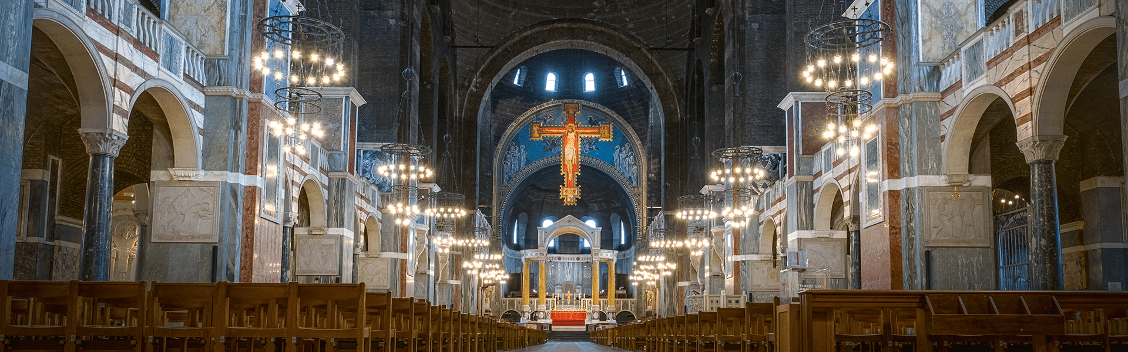
Racial Justice Sunday
16th February 2025
Notes:
Play some suitable reflection music as the pupils and staff gather for the Celebration of the Word.

Slide 2
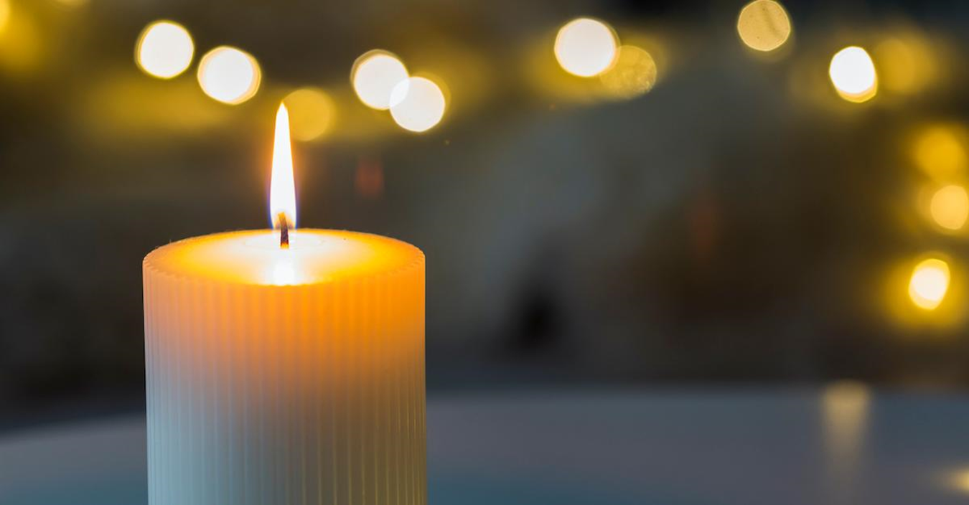

Opening Prayer
Notes:
Open by inviting the pupils and staff to pray –
In the name of the Father, and of the Son, and of the Holy Spirit,
Loving God,
You have created each of us in your image,
giving us dignity and worth beyond measure.
As we come together to reflect on the call for racial justice, open our minds and hearts to see your presence in one another.
Grant us the courage to walk as pilgrims of hope, building a world where all are valued and respected.
We ask this through Christ our Lord. Amen.

Slide 3

Racial Justice Sunday -
16th February
Pilgrims of Hope:
Our Journey Together
Towards Racial Justice
Notes:
Welcome the pupils and staff and explain that Racial Justice Sunday is taking place on the 16th of February across England and Wales.
It is an important day for Catholics to reflect on racial justice and commit to making a difference.
This year’s theme is linked to the Jubilee Year and is -
Pilgrims of Hope: Our Journey Together Towards Racial Justice.
It has now been 30 years since the first Racial Justice Sunday was celebrated. For three decades, this day has been a time to talk about unfair treatment in our society like racism and inequality. It is an opportunity to think about how we treat each other and how we can make things better together.
Our churches and schools have people from all kinds of backgrounds. Some are new to the country, while others have been here for generations. Everyone’s story matters - everyone has their own experiences and their own ideas about what the journey toward racial justice means to them.
This Racial Justice Sunday, we are invited to look at how far we’ve come in treating everyone fairly and with respect. But let’s also think about the work we still need to do to make sure everyone feels included and valued.
Explain that a pilgrim is someone on a journey, guided by faith and hope.
Emphasise that as a school community, we are on this journey together towards a fairer, more inclusive world.

Slide 4
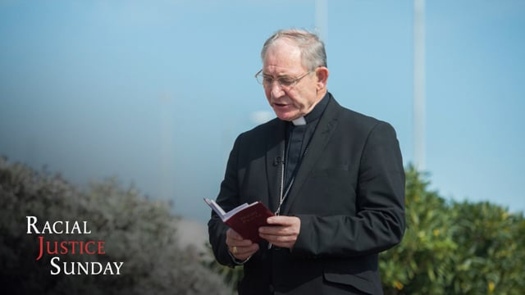
Video from Bishop Paul McAleenan
Bishop McAleenan's message for
Racial Justice Sunday 2025
Notes:
Follow link and play the video from Bishop Paul McAleenan

Slide 5
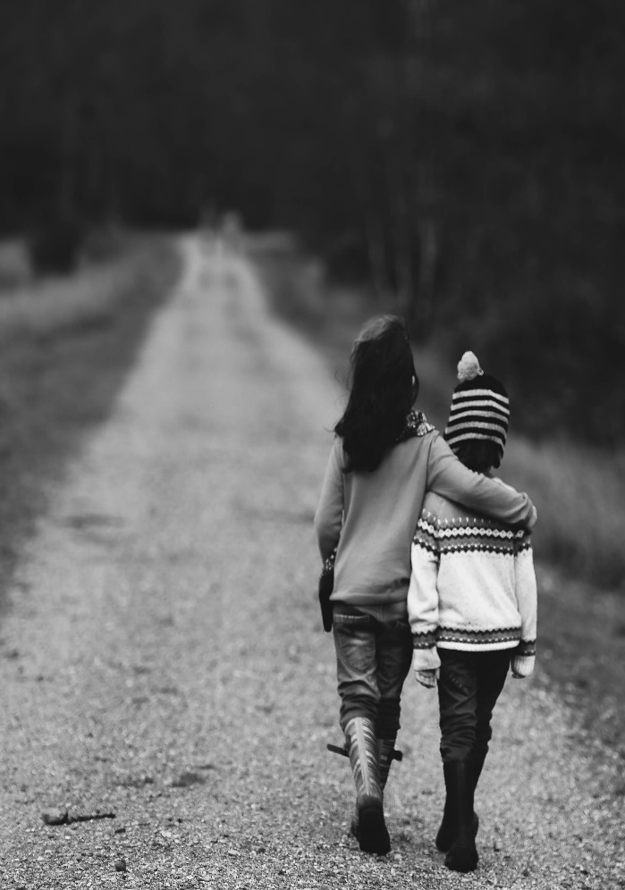
Being a Pilgrim of Hope
Means:
  Believing in change: Faith gives
  us the strength to fight for justice,
  even in difficult times.
  Taking Action: Working together for
  equality and fairness as a community.
  Supporting others: No one walks alone - we journey together.
Notes:
Explain what it means to be pilgrims of hope -
A pilgrim is someone on a journey with a purpose. We don’t have all the answers, but we walk forward with hope, guided by our faith.
By looking at the past and the present, acknowledging challenges and opportunities, we can hope and journey towards a more just future
Consider using the extended metaphor of a pilgrimage to help students understand the nature of such a journey – the adventure, excitement and discovery as well as the challenges, setbacks and uncertainty. When on pilgrimage, we can often take wrong turns, suffer bad weather or realise that we lack the right footwear. In these cases, we need to rely on others for help and support and to continue going in hope of reaching the final destination.
Believing in change
Hope gives us the courage to tackle big issues like racism and inequality, even when it feels challenging.
Taking Action
Racial justice is about actions as well as words – think about how you can stand up for others, understand the experiences of others, and learn from each other
Supporting others
Emphasise the importance of journeying together.
Racial justice is not something one person can achieve alone - it takes everyone working as a community, no matter your race or background.
Steps towards racial justice can be small but all efforts are meaningful

Slide 6
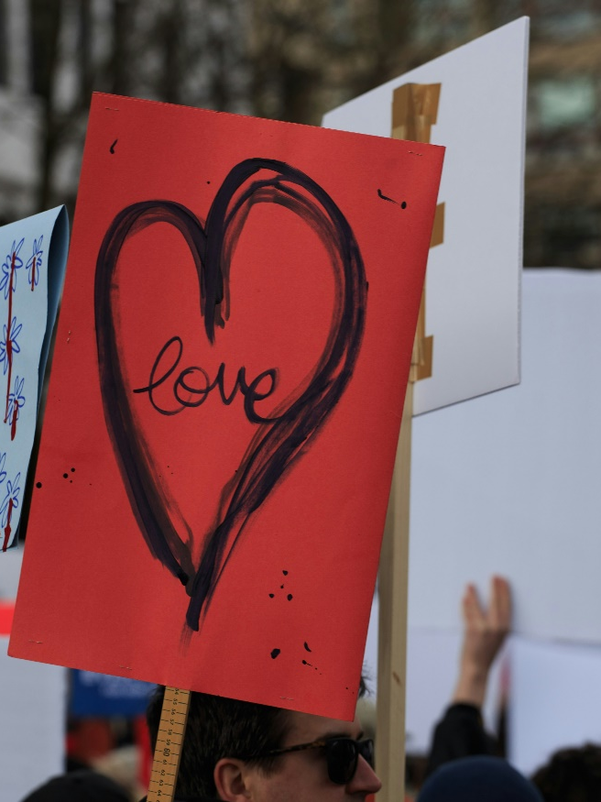
What did Jesus say…
  "You shall love your neighbour as yourself"
  (Matthew 22:39)
Notes:
Explain that
Jesus calls us to love our neighbours as we love ourselves.
Neighbours means everyone not just those who live near us.
And Jesus is saying that just as we look out for and look after ourselves, we must look out for and look after other people.
Highlight that
this includes people of every race, culture, and background.
Loving our neighbour means standing up against unfair treatment and working for a world where everyone feels included and valued.
Relate the verse to the theme:
As pilgrims of hope, our journey is guided by love - love for all our neighbours, especially those who have been treated unfairly because of their race.

Slide 7
Questions for Discussion
The Present:
What does racial justice mean to you?
What does racial justice look like in your school or neighbourhood?
The Past:
What are some of the challenges you know of that people in the past have faced when fighting for racial justice?
The Future:
What kind of actions can you take today for the world to be a fairer place in the future?
Notes:
Invite the students to reflect on their own journey towards racial justice: their understanding of it, their experiences in the school, their church or community. Emphasize that there are no right or wrong answers.
Inquire about what the students know about the past struggles towards racial justice.
Emphasise that a fairer future doesn’t just happen. It’s built by the choices we make today. What can the students do to make that better world a reality? It could be as simple as standing up for someone being treated unfairly, learning about different cultures, or even just being kind to others.
When reflecting on the past, you can consider the progress that has been made in racial justice and the ways in which the past is different to the present

Slide 8
Silent Reflection
Take a moment of silence to reflect on these questions:
Do I show love and respect to people from different backgrounds?
Are there times when I have stayed silent about unfair treatment instead of speaking up?
What can I do to make our school community a place of kindness and fairness?
Notes:
Explain
On our journey as pilgrims of hope, we need to pause and think about how we can do better.
Each small step we take, like showing respect or standing up for someone, helps us move closer to a world of racial justice.
Having considered the theme for Racial Justice Sunday and the scripture reading, spend a few moments in silence reflecting on these questions.

Slide 9
Our Mission
As Pilgrims of Hope:
Speak out when you see someone being treated unfairly.
Discuss with your friends how you can help others to feel included and welcomed in your community.
Learn more about other cultures and traditions.
Notes:
Explain that
being pilgrims of hope means taking action, not just thinking about change.
Speaking out takes courage, but it helps others feel supported.
Being a friend creates a sense of belonging.
Learning about different cultures shows respect and builds understanding.
Encourage students to choose at least one of these actions to practise this week.

Slide 10
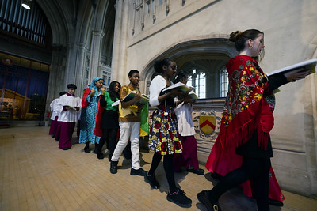
Closing Thoughts
Let us walk together as pilgrims of hope, spreading love and racial justice wherever we go.
Racial Justice Sunday Mass, January 2024
Notes:
Thank everyone for taking the time to reflect on this important theme.
Remind pupils and staff that being pilgrims of hope means working together to create a world of fairness and unity, one step at a time.
Encourage everyone to carry the message of racial justice with them as they go about their day and week.

Slide 11
Closing Prayer
Notes:
Close the Celebration of Word by inviting the pupils and staff to pray –
In the name of the Father, and of the Son, and of the Holy Spirit,
God of Justice and Peace,
You call us to walk together as pilgrims of hope, guiding our steps with love, truth, and compassion.
Help us to stand against racism in all its forms
and to celebrate the beauty of our diversity.
May our journey towards racial justice bring healing and unity to our world.
Through Christ our Lord.
In the name of the Father, and of the Son, and of the Holy Spirit, Amen.

