Slide 1
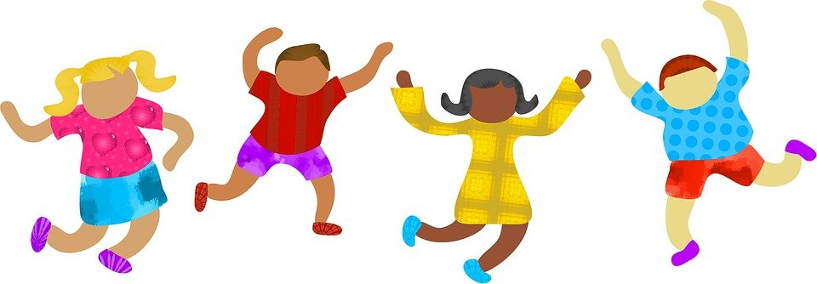

Racial Justice Sunday

Slide 2

What does it mean to be ‘just’ or fair?
What do we mean by ‘race?
Before we begin…

Slide 3
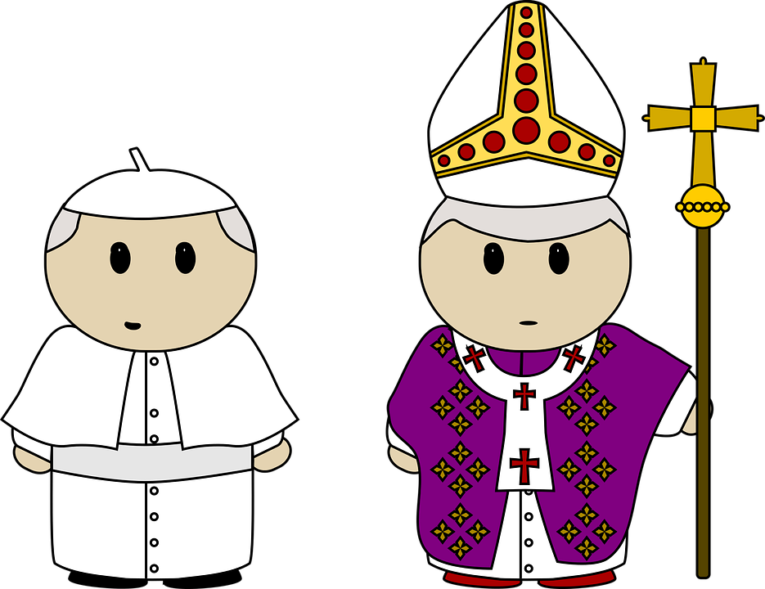
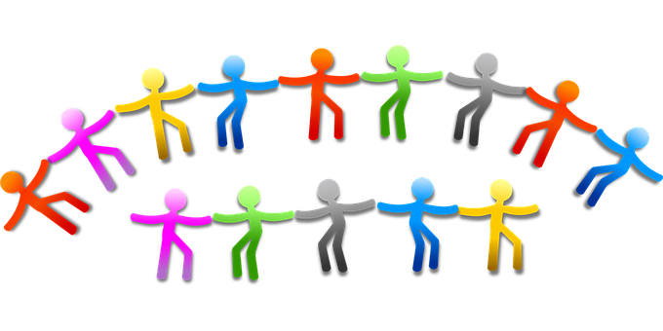
Walk together,
pray together
and work together.
This year the bishops in our country said that we should
Think: Why is this important?

Slide 4

As we gather together,
we pray for all those
who are sad
because of people’s bad actions.
Help us to make good choices
so that we can walk together, pray together and work together
with people of all races.
Help us to show God’s love
to everyone.
Amen
Gather

Slide 5



Jesus said to his disciples: ‘You are the salt of the earth. But if salt becomes tasteless, what can make it salty again? It is good for nothing, and can only be thrown out to be trampled underfoot be men.
You are the light of the world. A city built on a hill-top cannot be hidden. No-one lights a lamp to put it under a tub; they put it on the lamp-stand where it shines for everyone in the house. In the same way your light must shone in the sights of me, so that, seeing your good works, they may give the praise to your Father in heaven’.
Listen (Mt 5:13-16)

Slide 6
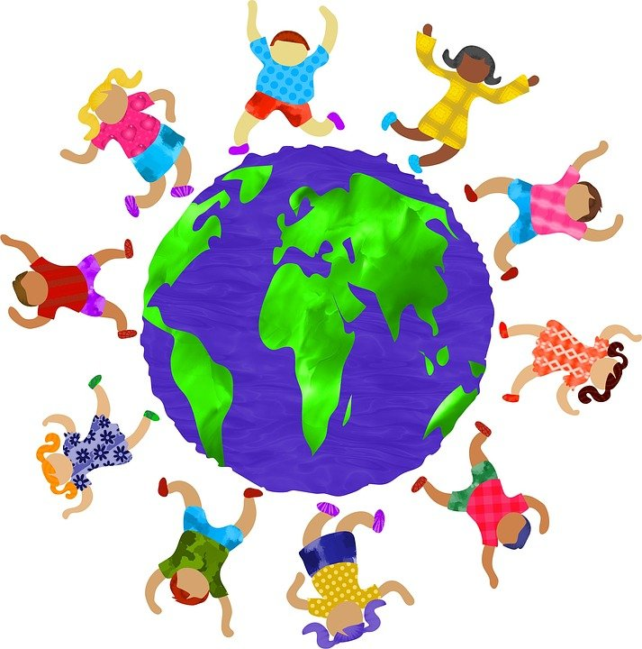
Have you ever been unfair or unkind to others? Say sorry to God
How can you be a ‘light’ and make the world a fairer place for all God’s people?
Reflect

Slide 7
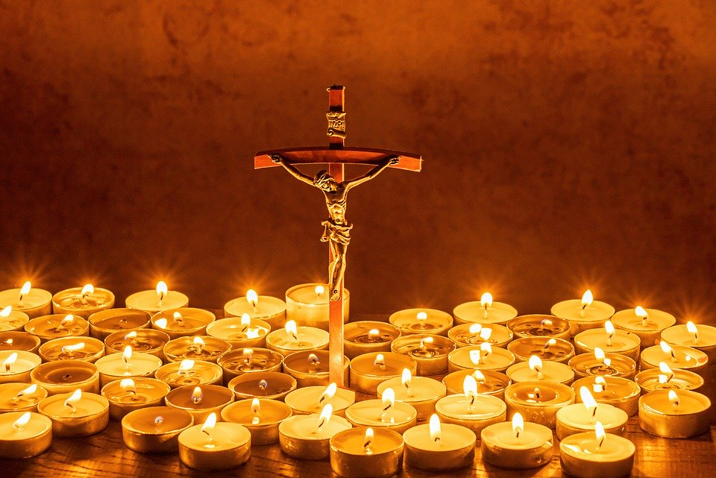
Let us pray

Slide 8
1. We pray for people of all races, that they will be treated kindly and fairly.
Lord hear us…
2. We pray for those who feel hurt or sad because of unfairness or racial injustice.
Lord hear us…

Slide 9
3. We pray for the leaders in our country that they will act now to bring about change for the better.
Lord hear us…
4. We pray that we will follow the example of Jesus by walking, praying and working together.
Lord hear us…
Our Father…

Slide 10
Sing (optional)
Walk in the light
One more step along the world I go
This little light of mine

Slide 11

Now: Complete an activity from the pack based on the theme and then live this out in your life:
Walking, praying and working together.
Consider: Creating a class or school display and then sending a photo to your Diocesan Adviser with a brief description of who you are and what you did.
Mission

