Slide 1
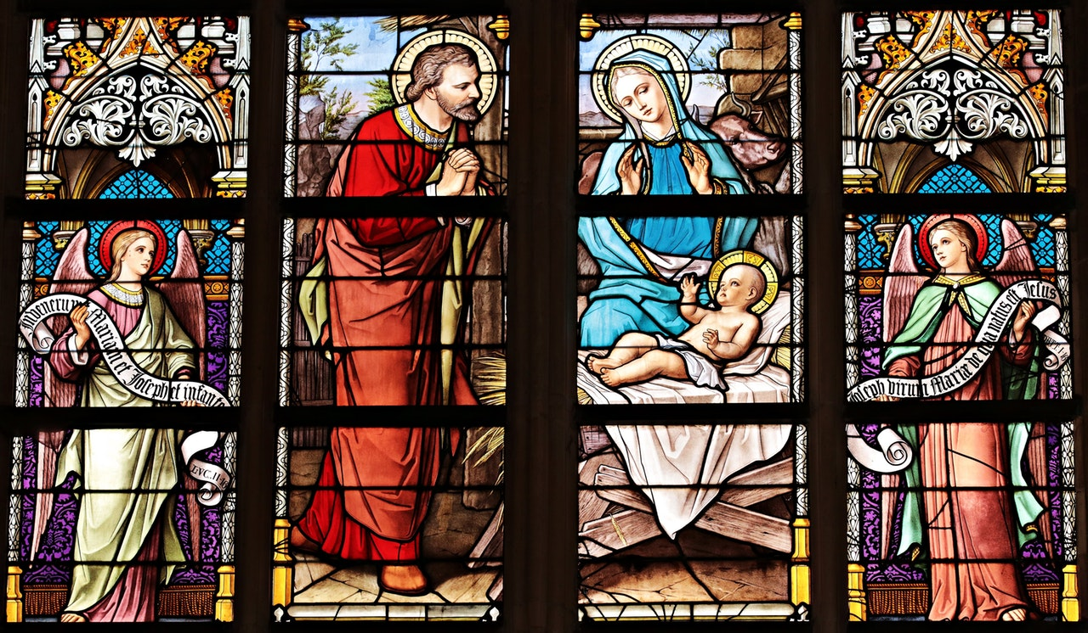
PRAISE TO YOU ETERNAL WORD

Slide 2

By your Word Almighty Father
all creation came to be.

Slide 3
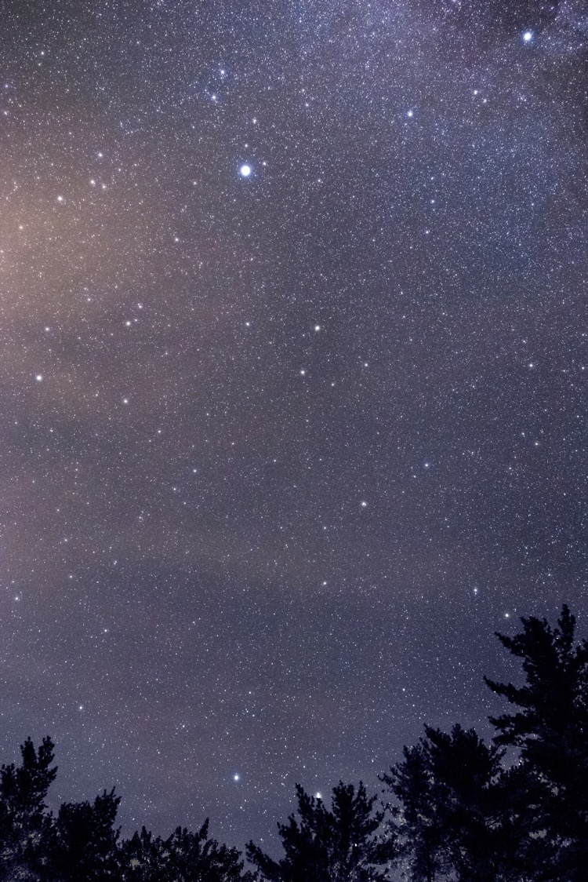
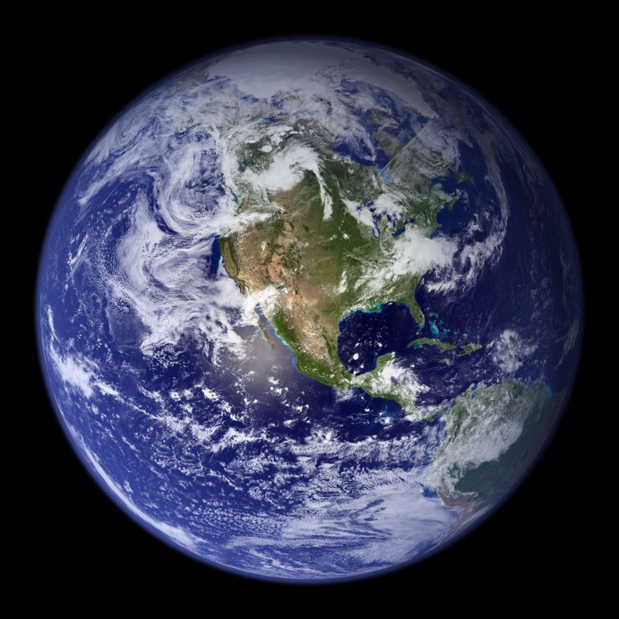
Beauty of the earth and heavens
called forth from eternity.

Slide 4
Word of life from the beginning
one with God in majesty.

Slide 5

In the scriptures we behold you
as the God who speaks in love.

Slide 6
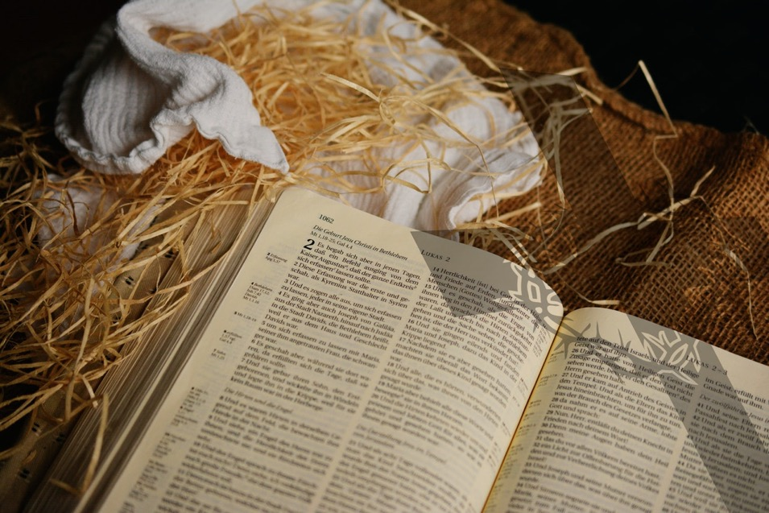
By your Son you then spoke to us
gift of grace from realms above.

Slide 7
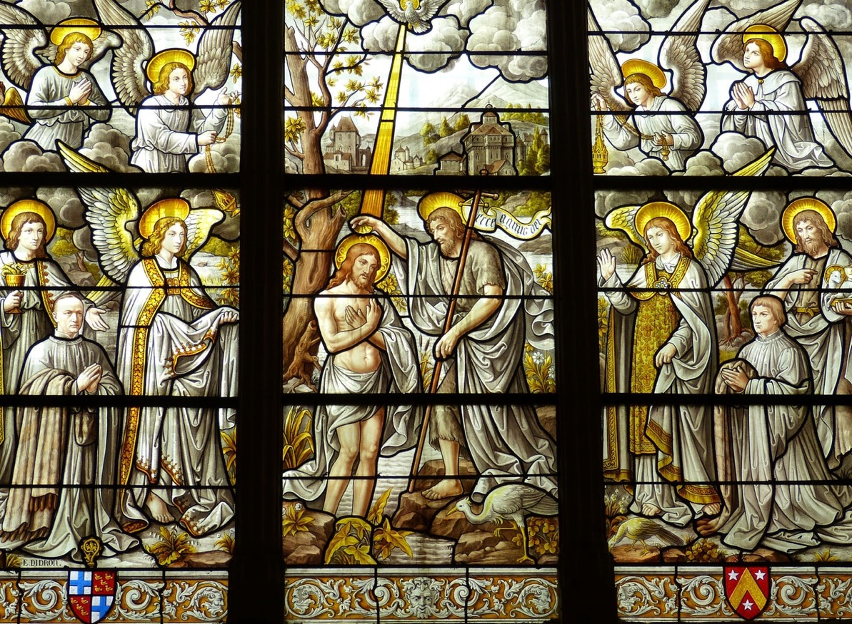
Radiant light of your great glory
Word who shows the Father’s love.

Slide 8
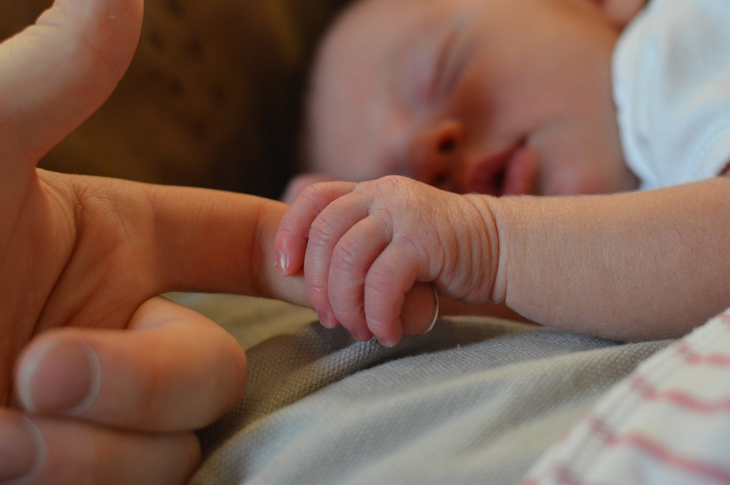
Saving Word you dwelt among us
took on flesh and bore our pain.

Slide 9
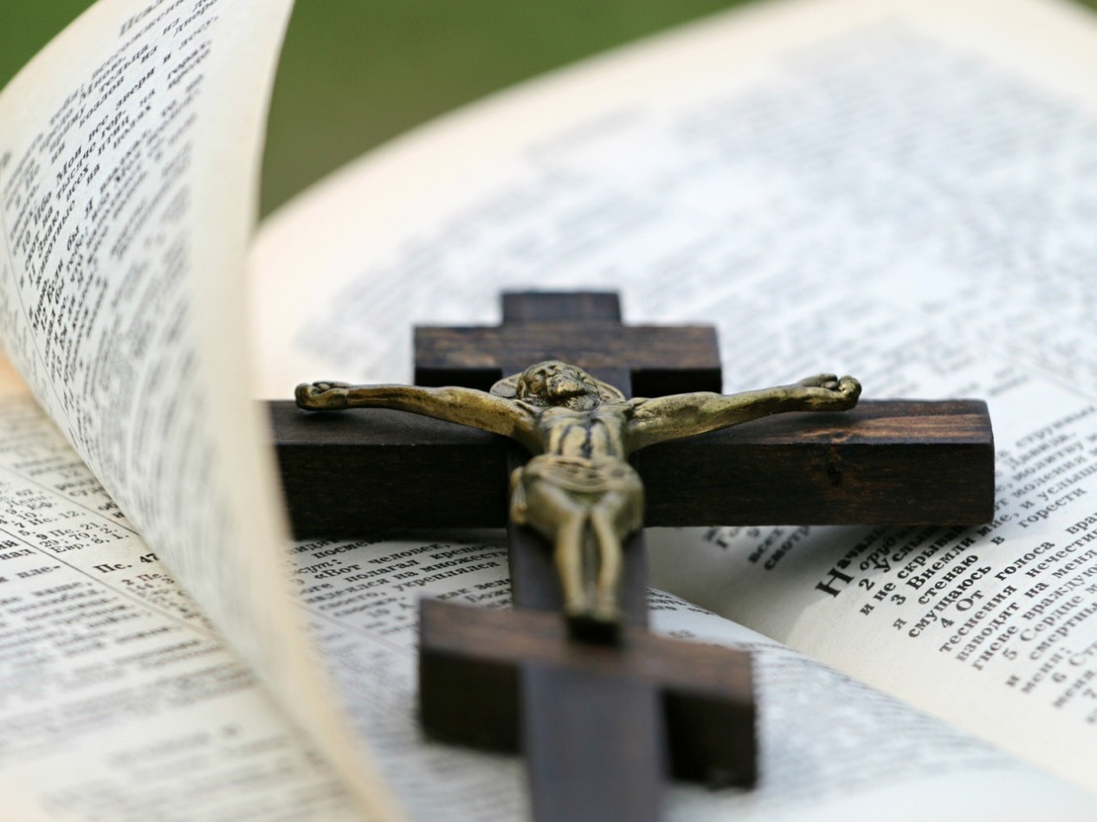
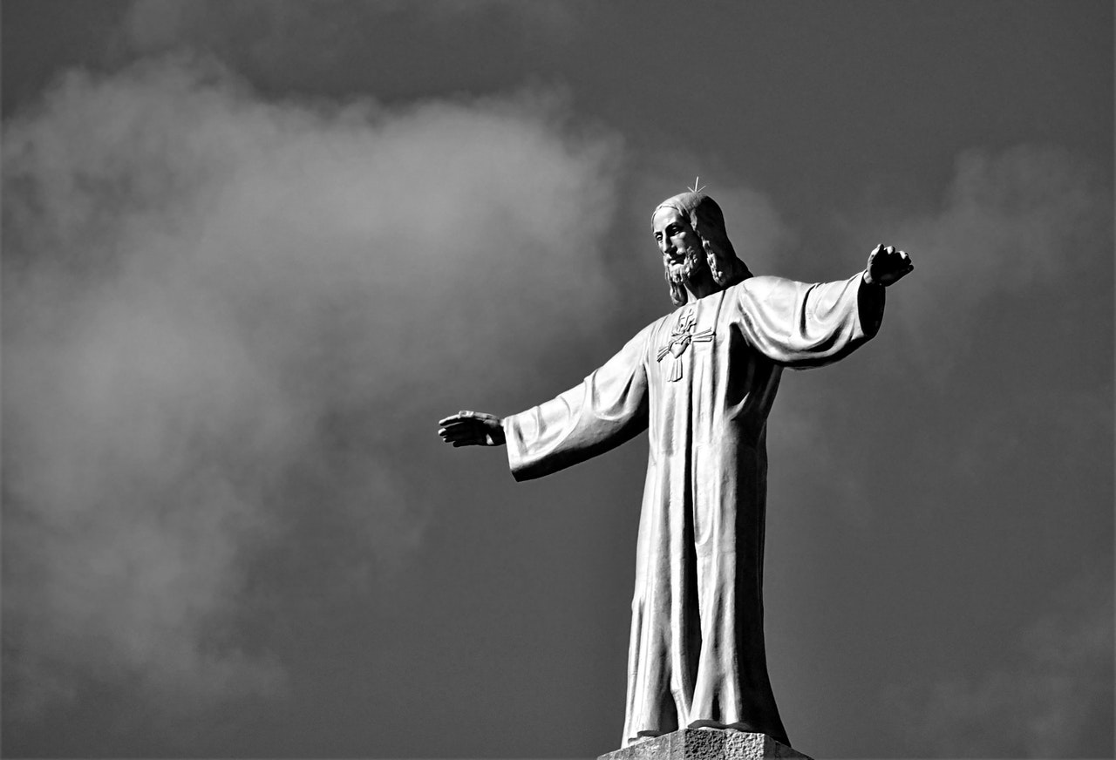
Shared in all our joys and sorrows
died for us and rose again.

Slide 10

Now ascended to the Father
glorious Word with mercy reigns.

Slide 11


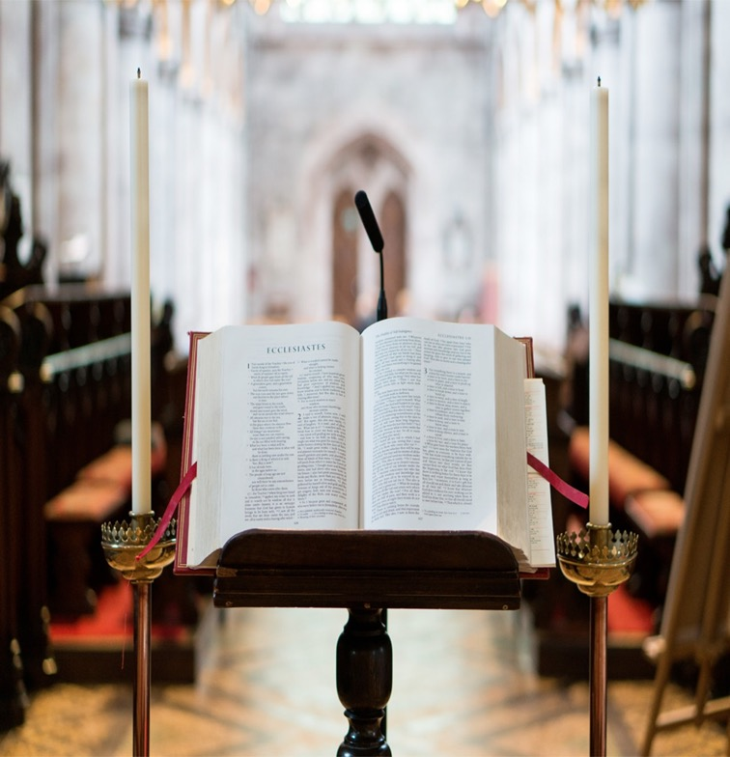
Grant us Lord the grace to listen,
help us trust and live your Word.

Slide 12

May it be a lamp to guide us
as we follow you O Lord.

Slide 13
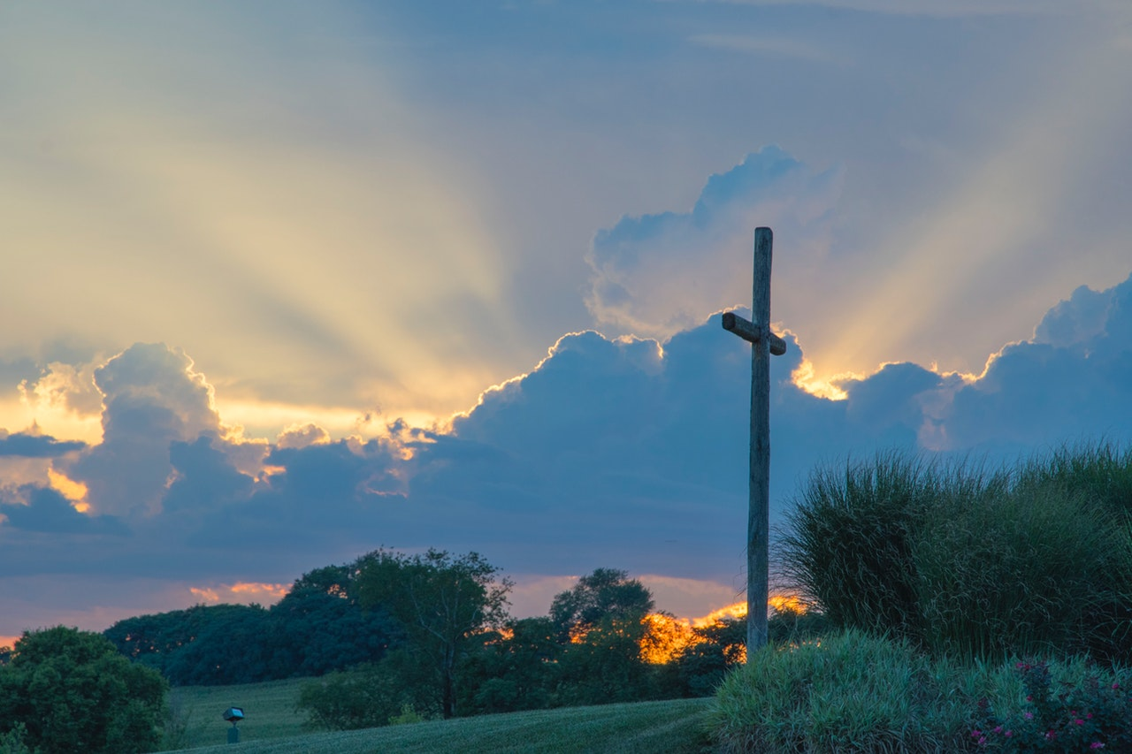
Praise to you Almighty Father,
Spirit and Eternal Word.

Slide 14
Acknowledgements
Words © Alex Heath 2019
Images from www.pexels.com
Praise to you Eternal Word may be sung to any tune with the metre 8.7.8.7.8.7
e.g. Praise my soul the King of Heaven
Further resources available from www.nores.org.uk (In the Classroom- Chaplaincy)
and www.northamptondiocese.org (Faith- Year of the Word)

