Slide 1
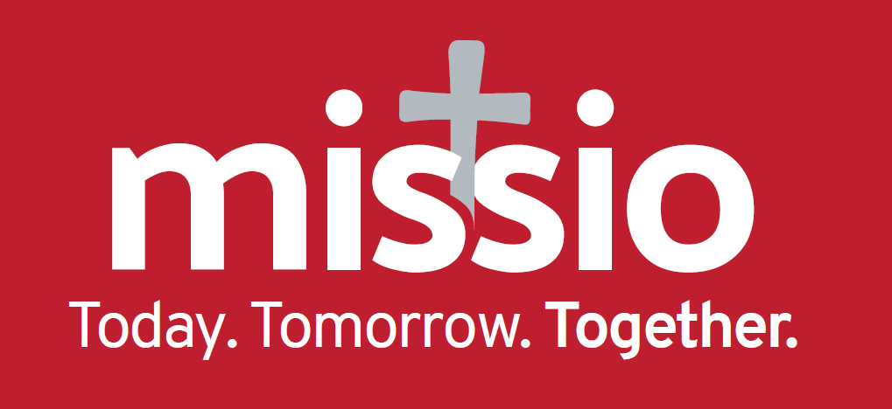
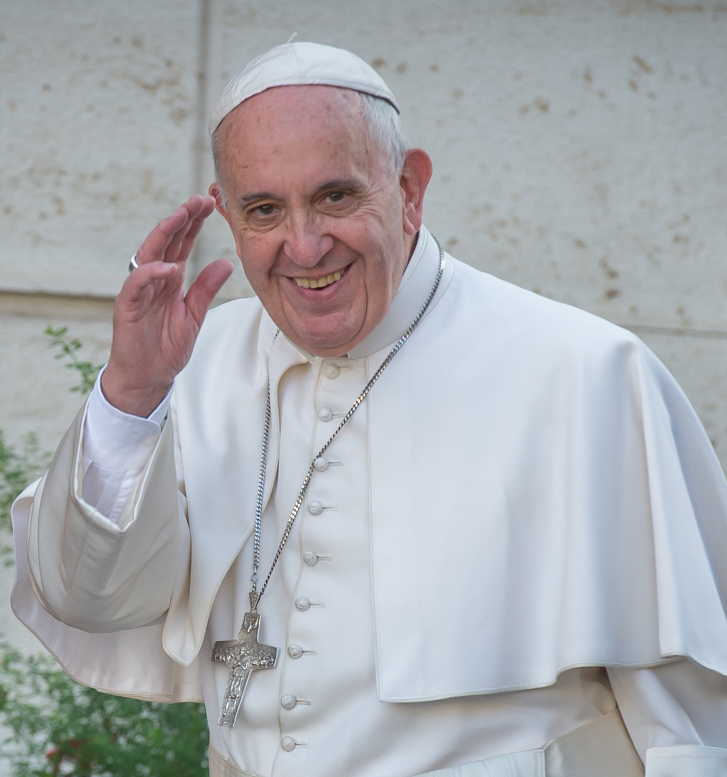

What is EMM2019?
EMM2019 is the
Extraordinary Month of Mission
Pope Francis has declared that October 2019 will be a special month of prayer and action to strengthen and grow God’s mission through the Church.

Slide 2




EMM2019 aims:
To encourage Catholics into a deeper relationship with Jesus through prayer.
To look to, and learn from, the actions and sacrifices of our saints, martyrs and living missionaries.
To financially support overseas mission, through Missio.
To rediscover and renew our understanding of overseas mission (missio ad gentes).

Slide 3

Is EMM2019 replacing World Mission Sunday?
No. EMM2019 and World Mission Sunday are separate but complementary events.
World Mission Sunday
is on 20 October 2019.
The theme is
‘Together we are Mission’.

Slide 4
Who is coordinating EMM2019?
Missio, also known as Pontifical Mission Societies.
Pope Francis asks schools, parishes, organisations, orders, dioceses, communities and individuals to get creative in supporting this global Church initiative.

Slide 5

When does EMM2019 start?
EMM2019 runs throughout October, but many are already celebrating this special occasion, and will continue until the end of the year.
Notes:
October is the focus month of EMM. However some religious orders have already begun to support it. Missio is aware that contemplative orders are already praying the EMM prayer, and mission congregations have begun promoting EMM2019.

Slide 6
EMM2019 WORLDWIDE CAMPAIGN
Missio is part of a global network of over 120 offices which support thousands of dioceses and communities.
To gather the collective energy of this network for EMM2019, a global campaign will run from August and we want everyone involved!
Notes:
Missio is part of a global network of over 120 offices. Together they support thousands of dioceses and communities. To gather the collective energy this network can make towards EMM2019, a worldwide campaign will begin in August - and they want everyone to get involved!

Slide 7
EMM2019 WORLDWIDE CAMPAIGN
The EMM2019 worldwide campaign has four elements:
1. Social Media Campaign (#MyMission #OurMission #EMM2019)
2. The EMM2019 Prayer
3. Universal Prayer Chain
4. EMM2019 Song: Baptised and Sent
Notes:
Missio is part of a global network of over 120 offices. Together they support thousands of dioceses and communities. To gather the collective energy this network can make towards EMM2019, a worldwide campaign will begin in August - and they want everyone to get involved!

Slide 8

SOCIAL MEDIA CAMPAIGN
The EMM2019 social media campaign aims to:
Celebrate that no matter where we are, our faith connects us with millions of others as one Church family.
Highlight that, individually and collectively, we are called to share God’s love with everyone.

Slide 9
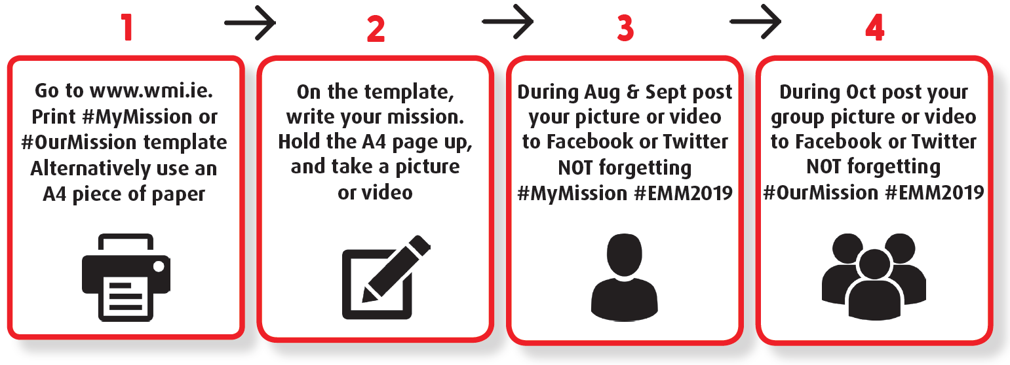
#MyMission
From 1 August, we ask individuals to use their social media profiles (Facebook, Twitter and Instagram) to share their personal mission, using the hashtags #MyMission #EMM2019.
#MyMission asks you to proudly let the world know how you, like missionaries overseas, are called to reach out and share God’s love.
For example, #MyMission could be a simple act of kindness, like visiting an elderly neighbour, or a bigger gesture, like volunteering with or supporting a charity.

Slide 10

#MyMission

Slide 11




Slide 12
#OurMission
On 1 October, the campaign moves from individuals to groups. Groups can share their mission on social media using the hashtags #OurMission #EMM2019.
#OurMission asks schools, organisations, orders, congregations, dioceses, parishes and communities to step up and let the world know their collective mission.
Perhaps your contemplative order’s mission is to pray the EMM2019 prayer. Or perhaps your school’s mission is to make everyone welcome and included.

Slide 13

#OurMission

Slide 14
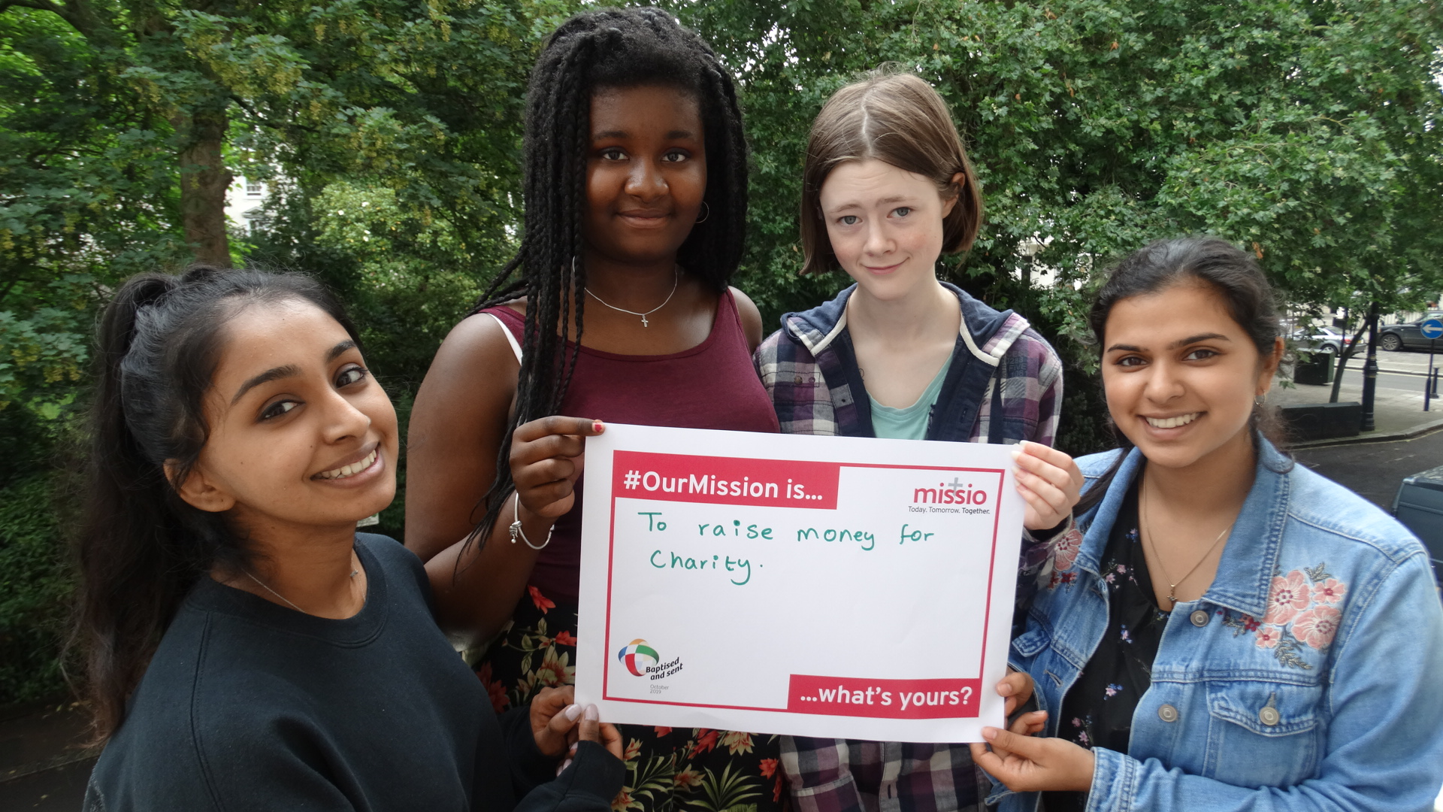
#OurMission

Slide 15
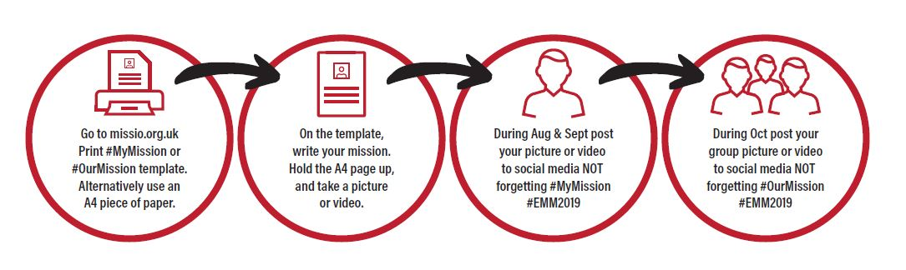
SOCIAL MEDIA CAMPAIGN – HOW IT WORKS

Slide 16


THE EMM2019 PRAYER
The special EMM2019 prayer card will be made available to parishes and can also be found on our website: missio.org.uk/emm

Slide 17
UNIVERSAL PRAYER CHAIN
When we pray together, we share in God's love and are inspired to make the world a better place.
During October, Pope Francis invites everyone to join the EMM2019 Universal Prayer Chain, in solidarity and love for all people.
This will connect the whole Church family and give us strength to live our Catholic mission.

Slide 18
UNIVERSAL PRAYER CHAIN
Who? Everyone, everywhere, all over the world is invited to pray the official EMM2019 prayer.
When? Every Friday after the Angelus, throughout the month of October.
Why? Through praying together we will revitalise and reawaken our missionary spirit.

Slide 19
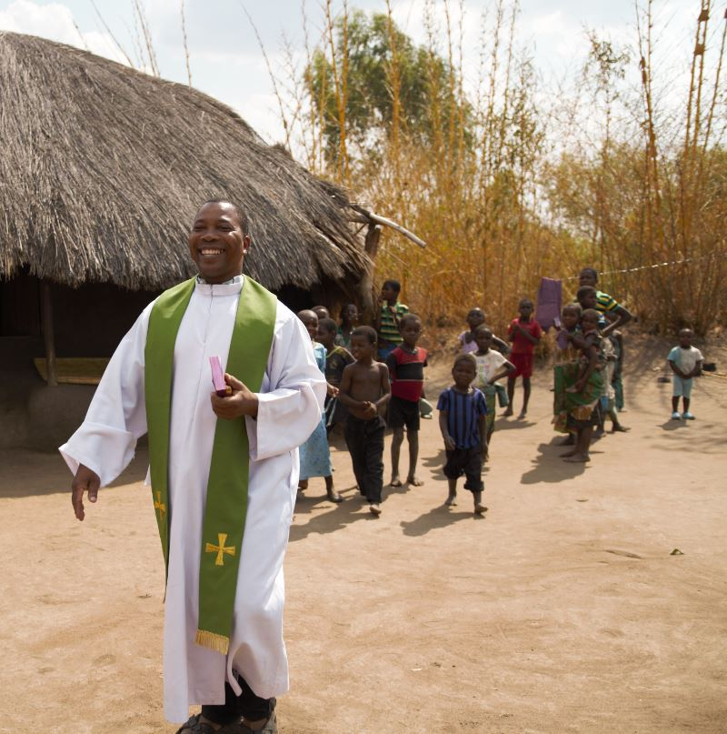

EMM2019 Song: Baptised and Sent
The EMM2019 song will be available on our website from the beginning of September: missio.org.uk/emm
CHORUS:
Baptised and sent,
Baptised and sent,
To share the joy in every continent
all that is broken we are called to mend
God is our friend,
Baptised and sent,
Baptised and sent,
We’ll light a hope where there is just despair
Show that we care
His love has no end

Slide 20

Telephone: 020 7821 9755
Email: emm2019@missio.org.uk
Website: missio.org.uk/emm

