Slide 1

Jesus is alive – go and tell my brothers.
Session
Three

Slide 2

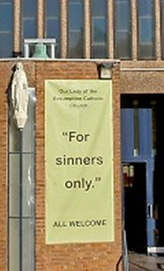
Jesus is alive
Eric’s
Story

Slide 3

‘As I walked past the church that day the new sign struck me
– it just said:
“For sinners only.”
I felt as though someone had put it there for me.’
Jesus is alive

Slide 4
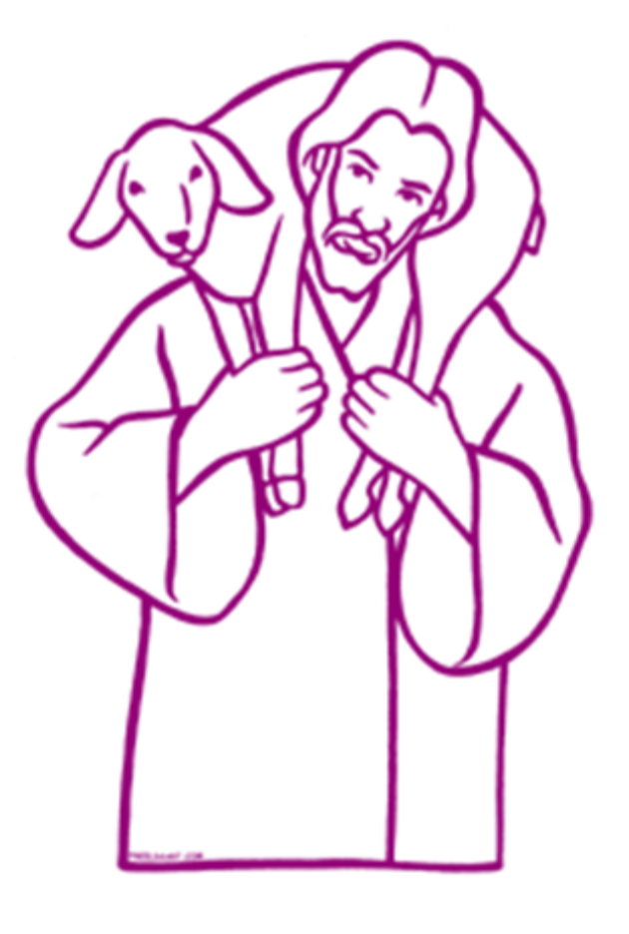
Jesus is alive
Scripture:
Luke 15:1-7
And when he comes home, he calls together his friends and neighbours, saying to them, “Rejoice with me, for I have found my sheep that was lost.”

Slide 5


Jesus is alive
“Sometimes as a Church we have devoted the majority of our efforts to looking after the ninety-nine sheep safe in the fold. Today the majority of those who might be described as ‘lost sheep’ are perhaps too often left to fend for themselves.”

Slide 6

Questions to ponder
What can we learn from Eric’s story and from the scripture reflection?
Have you ever lost your way in life?
What brought you back to God?
Who do you think are the people the Good Shepherd is seeking out today?
Jesus is alive

Slide 7

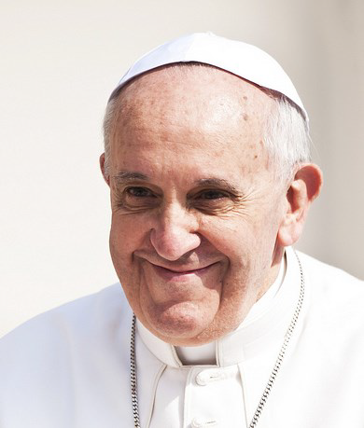
Jesus is alive
From
“The Joy of the Gospel”
by Pope Francis

Slide 8

“The Joy of the Gospel”
Whenever we encounter
another person in love,
we learn something new
about God.
Whenever our eyes are opened to acknowledge the other,
we grow in the light of faith
and knowledge of God.
(272)

Slide 9
“The Joy of the Gospel”
All this demands on the part of the evangeliser certain attitudes which foster openness to the message: approachability, readiness for dialogue, patience, a warmth and welcome which is non-judgmental. (165)

Slide 10
Some questions to talk about
1. Pope Francis said: Whenever we encounter another person in love, we learn something new about God. (272)
What do you understand by these words and how might you respond to them each day?
2. Pope Francis recommends: certain attitudes and attributes as critical for sharing the Good News: approachability, patience, dialogue, warmth and welcome which is non-judgemental. (165)
As you look back on your life this week, which of these are you aware of and which do you need to develop?

Slide 11

Take a moment to pray
Be still
and know
that you are
in the presence of God.

Slide 12

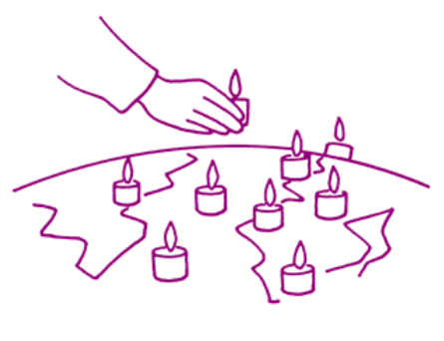
We pray for everyone who is feeling lost today:
for people who find no meaning to their lives,
for people suffering from addiction,
for those seeking happiness
in destructive and unfulfilling ways,
for those who feel isolated and insignificant.
We pray for everyone who is a follower of Jesus.
We ask for His help to be like our Good Shepherd,
to seek out those who are lost.
May we be used as instruments
to help them find their way home to Him.

Slide 13

Loving Lord Jesus,
You are the source of Truth and Life.
Through the grace of our baptism,
and in response to your Word,
May we be compelled
to respectfully and joyfully
reach out to everyone we meet
with compassion,
Always attentive to those in our midst
most in need of help.
Amen.

Slide 14

Acknowledgements
Session prepared by the Vicariate for Evangelisation, Archdiocese of Liverpool.
www.catholicnews.org.uk/proclaim15
Artwork: Mille images d’Eglise by Jean-Francois Kieffer
Pope photo.: © Mazur/catholicnews.org.uk

