Slide 1

Learning to be a missionary disciple
- sitting at the feet of Jesus.
Session
Two

Slide 2

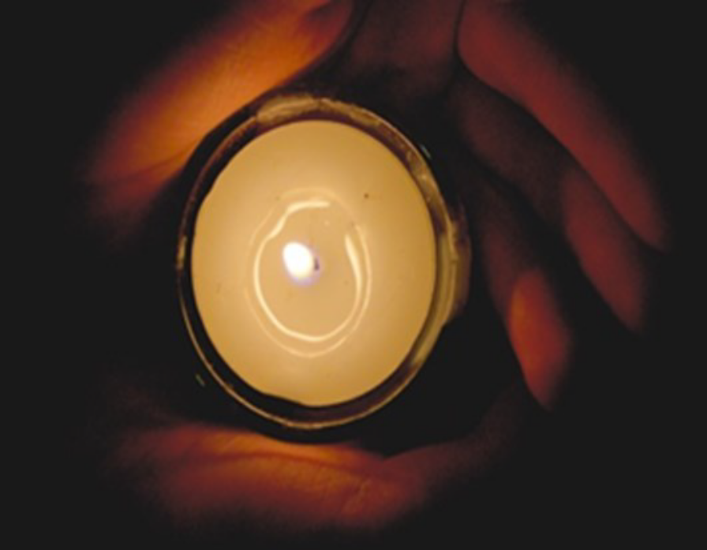
Learning to be
a missionary disciple
Janet’s Story

Slide 3


“I started to see that Jesus wanted to be part of my life and my future.”
Learning to be
a missionary disciple

Slide 4
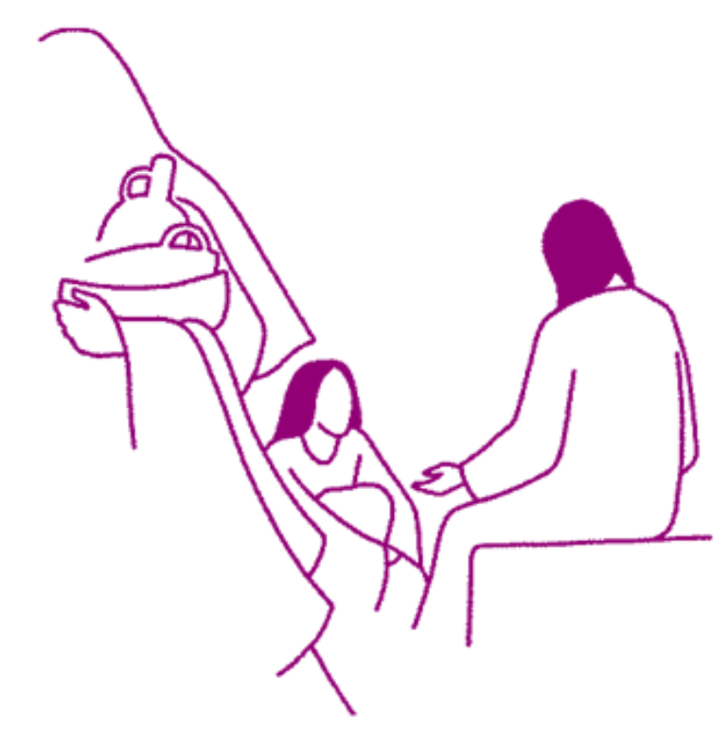
Learning to be
a missionary disciple
Scripture:
Luke 10:38-42
“Martha, Martha, you are worried and distracted by many things; there is need of only one thing.”

Slide 5

Learning to be a missionary disciple
Take time every day
to listen to the Truth
that sets us free.
Give some time
every day
to the One
who has given us
everything He has,
who comes
so that we will know
the fullness of life
and that our joy
will be complete.

Slide 6

Questions to ponder
What can you learn from Janet’s story and from the scripture reflection?
When do you take time to listen to Jesus and how has listening to Jesus changed you?
Jesus says that His Kingdom is like a hidden treasure.
What are you most grateful for today?
Who in need and in distress might you resolve to pray for and how might you practically live out your discipleship of Jesus?

Slide 7
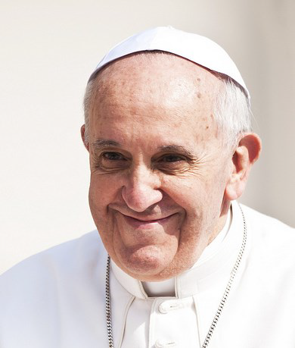
Learning to be
a missionary disciple
From
“The Joy of the Gospel”
by Pope Francis

Slide 8

“The Joy of the Gospel”
The parish is not an outdated institution; precisely because it possesses great flexibility...
In all its activities the parish encourages and trains its members to be evangelisers.
It is a community of communities, a sanctuary where the thirsty come to drink in the midst of their journey, and a centre of constant missionary outreach.
We must admit, though, that the call to review and renew our parishes has not yet sufficed make them completely mission-oriented. (28)

Slide 9
“The Joy of the Gospel”
I prefer a Church which is bruised, hurting and dirty because it has been out on the streets,
rather than a Church which is unhealthy from being confined and from clinging to its own security...
at our door people are starving and Jesus does not tire of saying to us: “Give them something to eat”
(Mk 6:37). (49)

Slide 10
Some questions to discuss
1. In what ways are we already living out the vision of Pope Francis to be a missionary parish, an open door community?
2. The Pope presents a challenging image of the Church – bruised, hurting and dirty.
How is this reflected in what happens in our parish and in how we pray together?

Slide 11

Take a moment to pray
Be still
and know
that you are
in the presence of God.

Slide 12

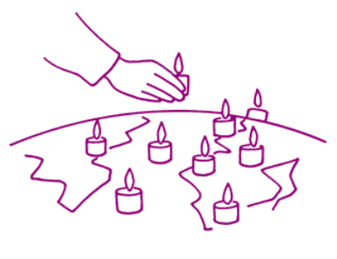
We pray for people whose lives are too busy,
who can’t find time to just be still
and know the gentle presence of God at their side.
We pray that our parish will always be a place where people are drawn into prayer and real listening to the Word that God longs for us to hear.
We ask God that we may never be unchanged or unmoved when we listen to His Word.

Slide 13
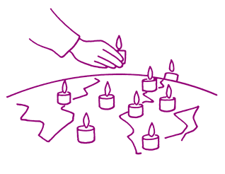
Loving Lord Jesus,
you call us to follow you into Life.
As we listen to your Word
may your life grow within us,
bringing us peace and deep joy.
May what we discover in you
stir us to reach out
in love and service to others.
Amen.

Slide 14

Acknowledgements
Session prepared by the Vicariate for Evangelisation, Archdiocese of Liverpool.
www.catholicnews.org.uk/proclaim15
Artwork: Mille images d’Eglise by Jean-Francois Kieffer
Pope photo.: © Mazur/catholicnews.org.uk

