Slide 1

Meeting Jesus – the only one who can save me.
Session
One

Slide 2

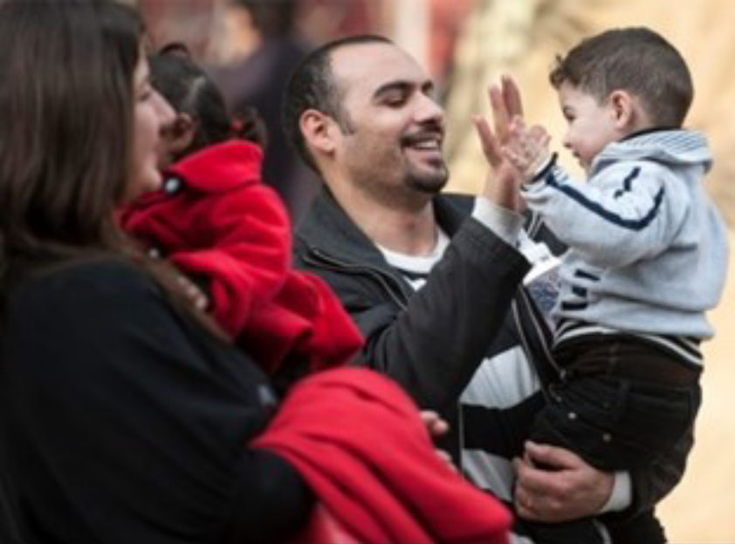
Meeting Jesus
Danny’s Story

Slide 3

“Something Father said about how blessed we are really hit home.
He told us to look at the cross and to know how much God loves each one of us.”
Meeting Jesus

Slide 4
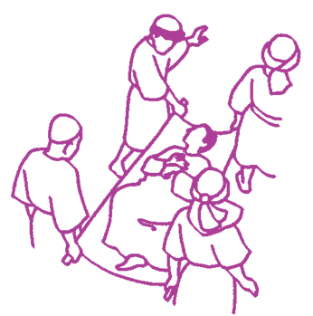
Meeting Jesus
Scripture:
Mark
2:1-12
When Jesus
saw their faith,
he said
to the paralytic,
“Son, your sins are forgiven.”

Slide 5

Meeting Jesus
“This is
the joy of the gospel
– to discover the gentle
and healing
mercy of Jesus
for me today.”

Slide 6

Questions to ponder
What can we learn from Danny’s story and from the scripture reflection?
What are the things in life you struggle with that might need the healing and forgiveness of Jesus today?
How might you, in the coming week, help to bring people to a place where they might meet Jesus for themselves?

Slide 7
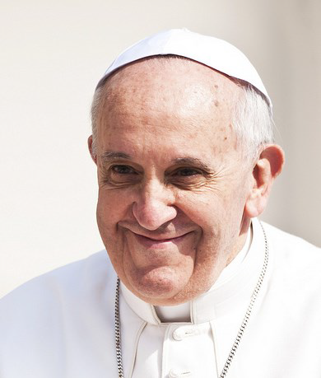
Meeting Jesus
From
“The Joy of the Gospel”
by Pope Francis

Slide 8

“The Joy of the Gospel”
On the lips of the catechist
the first proclamation
must ring out over and over:
“Jesus Christ loves you;
he gave his life to save you;
and now he is living at your side every day to enlighten, strengthen and free you”.
(164)

Slide 9
“The Joy of the Gospel”
I invite all Christians, everywhere, at this very moment, to a renewed personal encounter with Jesus Christ, or at least an openness
to letting him encounter them;
I ask all of you to do this unfailingly each day.
No one should think that this invitation is not meant for him or her, since “no one is excluded from the joy brought by the Lord”. (3)

Slide 10
“The Joy of the Gospel”
For if we have received the love which restores meaning to our lives, how can we fail to share that love with others? (8)

Slide 11
Some questions to talk about
1. How did you feel when reflecting on Pope Francis’ invitation to have
a personal encounter with Jesus every day?
What is your response?
2. What opportunities are there already in your community for learning to pray
and for growing in prayer?
What else would you like to see
offered in your parish?

Slide 12

Take a moment to pray
Be still
and know
that you are
in the presence of God.

Slide 13

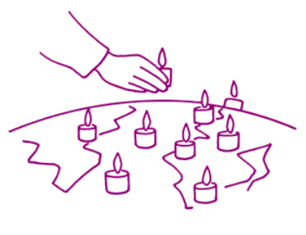
We ask God to bless the work of everyone who offers welcome and encouragement to those who come to our churches: those who come for a funeral, a wedding or a baptism, families involved in preparing for a First Holy Communion or Confirmation of a child, people who come back to Church after a long time away.
We pray for everyone who is broken and hurting and needs the love and mercy of Jesus.

Slide 14
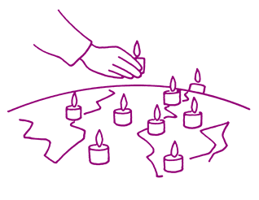
Loving Lord Jesus,
may we be open
to meeting with you heart-to-heart each day.
May these encounters transform us
and lead us more deeply
into the mystery of your presence.
Through the power of your life-giving Holy Spirit, may we radiate your presence so that others may be drawn to the life of faith. Amen.

Slide 15

Acknowledgements
Session prepared by the Vicariate for Evangelisation, Archdiocese of Liverpool.
www.catholicnews.org.uk/proclaim15
Artwork: Mille images d’Eglise by Jean-Francois Kieffer
Pope photo.: © Mazur/catholicnews.org.uk

