Slide 1



Notes:
Welcome to your Little Way Week Assembly.
Use the notes on each slide to present this assembly to your class or school.
The assembly lasts up to 20 minutes.

Slide 2

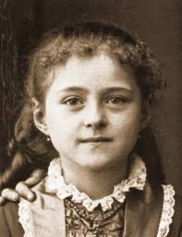
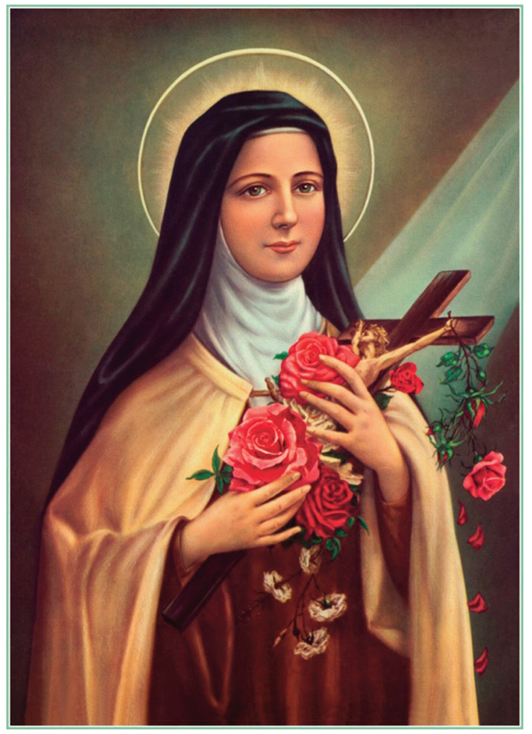
St Thérèse of Lisieux
Notes:
Ask the children if they know who either of these people are. Even if they don’t know, perhaps they might guess from the clues in the picture that the lady on the right is a saint.
The answer is that they are both the same person!
Click once to reveal her name – St Thérèse of Lisieux.
When she was a little girl, St Thérèse was known as Thérèse Martin. She lived in France over one hundred years ago and she led a very ordinary life – probably not much different to how the children live their lives today. She played with her four older sisters, went to the local school and enjoyed walks in the countryside with her family. She loved reading and dressing up and her daddy called her his ‘little queen’.
In this assembly you will find out how little Thérèse Martin became St Thérèse, and you might be surprised at how ordinary people can do extraordinary things through little acts of love.

Slide 3
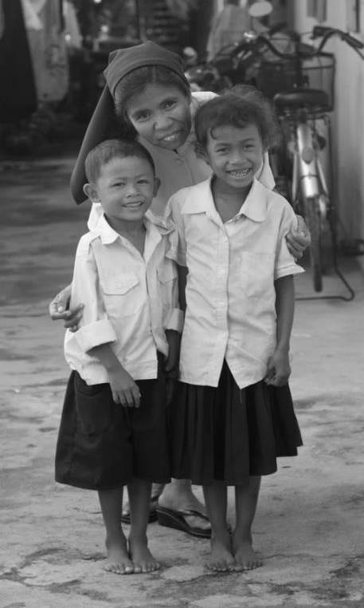
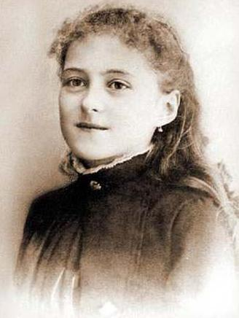
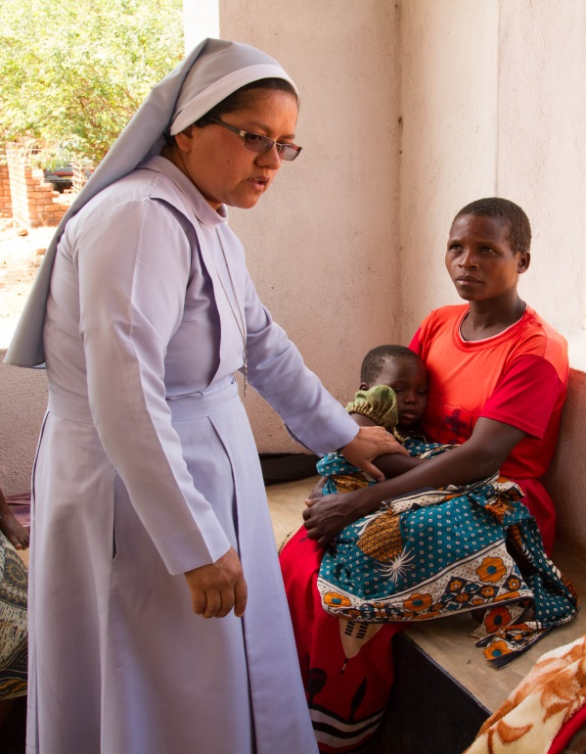
Notes:
From a young age Thérèse went to church every week with her family. She also prayed with them at home and was encouraged by her parents to follow the example of Jesus by being kind to everyone and helping those who were suffering.
But although Thérèse asked God to help her do what was right, she like all of us, sometimes did things that were wrong. As a little girl Thérèse was stubborn, would refuse to do housework, and liked to get her own way.
Ask for a show of hands: Who else sometimes finds it difficult to do as they are asked by their parents? Who else doesn’t like doing chores like washing the dishes or tidying up? They are not alone!
In spite of her occasional wrongdoing, Thérèse really did want to make good choices and she prayed that God might help her to do so.
From when she was a little girl, Thérèse always believed that God listened to her prayers and was very close to her. As she grew she decided that she wanted to be very close to God too. Thérèse told her family that she wanted to become a nun and do great things for God.
Ask if any of the children can explain what a nun is. Click to reveal first of two images.
A nun is a woman who chooses to spend her life loving God and helping others in a special way. They leave their family and friends to live with other nuns in a building called a convent. The nuns spend their time together praying for others and for the world. They also do what they can to help people practically so that everybody might know how much God cares for us.
Thérèse told her family that she wanted to be a certain kind of nun. Click to reveal second image.
She wanted to be a missionary nun. That’s a nun who delivers God’s love in places far away, in foreign countries where people are suffering and in need of help. Thérèse was so determined to do this, that at 14 she went to her local convent and asked the nuns if she could join them. But they told Thérèse she was too young and should wait until she was older.

Slide 4
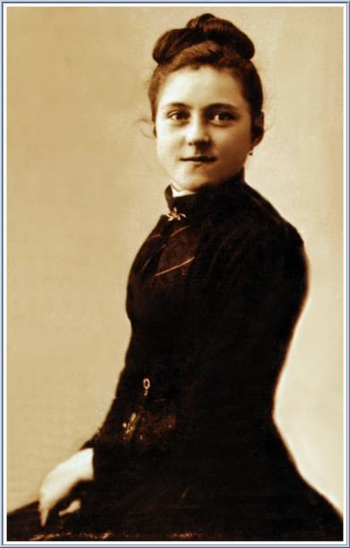
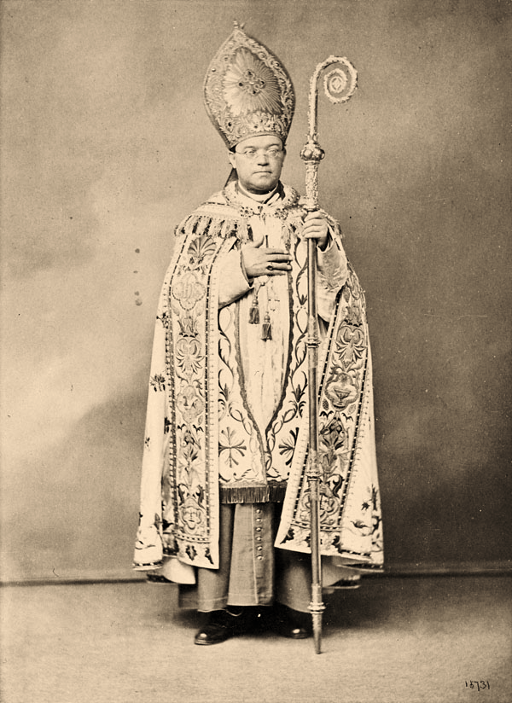
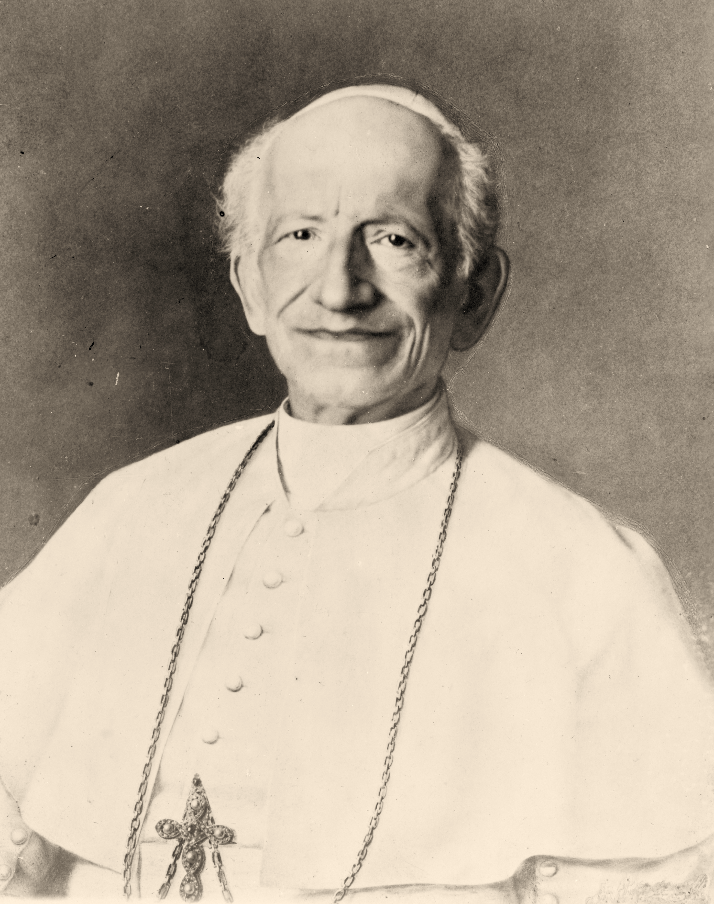
Notes:
But Thérèse didn’t want to wait. She made a plan. She put up her hair to make herself look older and went to see the Bishop to ask him if she could enter the convent (click to reveal image of Bishop). But the Bishop also told Thérèse she was too young. Undeterred, Thérèse convinced her father to travel with her to Rome.
Does anyone know where Rome is and which special person lives there?
Rome is in Italy, which is in Europe. And the special person who lives in Rome is the Pope.
Does anyone know who the Pope is and what he does?
The Pope is the head of the Catholic Church and his role is to help people follow the example of Jesus and love one another. Our Pope today is called Francis. But in Thérèse’s lifetime, the Pope was called Leo (click to reveal image of Pope Leo XIII)
Pope Leo’s staff told Therese and her father that in spite of their long journey, they were not allowed to speak to the Pope. This wasn’t going to stop Thérèse; she was determined to meet with Pope Leo and would not leave until she did so. Her persistence paid off and she was allowed to meet with him.
When Thérèse met Pope Leo, what do you think she asked him?
She asked him if she could join the convent and become a nun.
The Pope told Thérèse to listen to her Bishop and the older nuns; if they felt she was too young then she would have to wait. But that was not enough for this very determined young lady! She rested her hands on the Pope’s knees and begged him to help her. Gazing at her kindly, the Pope replied, 'Go - go - you will become a nun if it is God’s will.’
Thérèse trusted in God’s plan for her. She prayed that she would make good choices and never be discouraged.
Ask if the children can think of a time when they felt strongly that they’d made a good choice. Examples might be speaking out for someone who has been treated unfairly, or not giving up when faced with a difficult task.
Maybe, like Thérèse, they asked God to help them. Maybe in the future they could pray for God’s help and guidance again.

Slide 5
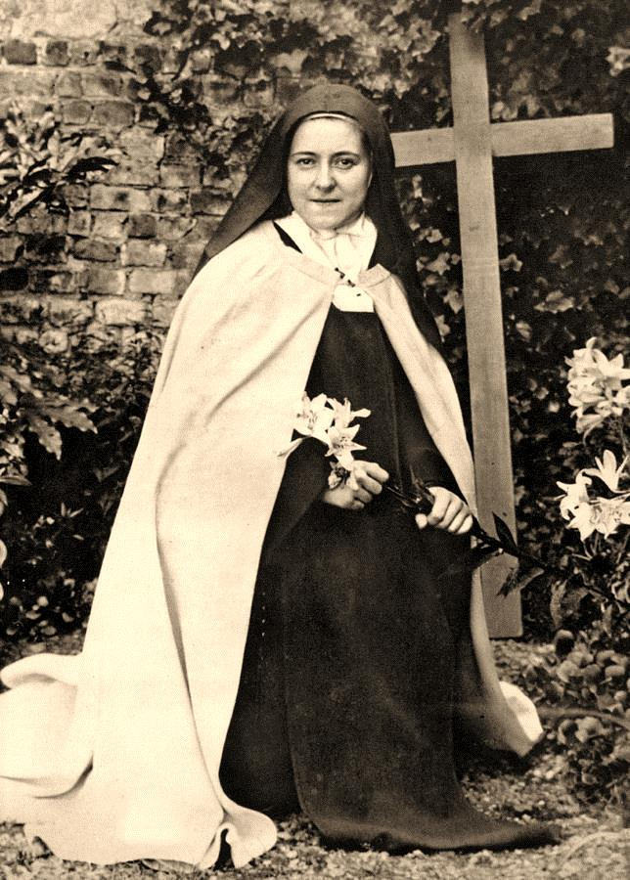
Notes:
Due to her determination, when she was only 15, Thérèse finally did become a nun but not a missionary nun. It was felt that Thérèse wasn’t strong enough to make long and difficult journeys to far away lands. Once again Thérèse was determined that she was not going to be defeated. Although she too realised that she couldn’t become a missionary, she decided that she would find another way to do great things for God.
The way she did this was quite extraordinary. In the convent Thérèse, like the other nuns, was given lots of ordinary tasks to do such as scrubbing the floor, cleaning the bathroom, washing up. Knowing that she wasn’t going to be a great missionary, Thérèse decided that everything she did each day - especially the small tasks - she would do with great love. She called this her ‘Little Way’.
Soon her decision to do little things with great love became part of her life. She made sure to be cheerful and do as she was asked. These might seem like tiny acts, but remember how as a girl Thérèse had hated chores, was stubborn, and had wanted her own way.

Slide 6
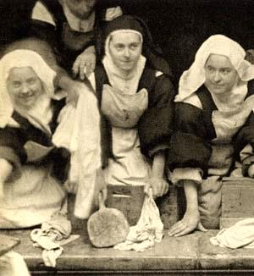
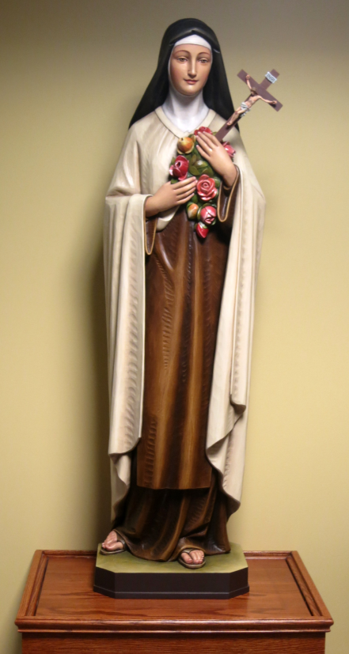
Notes:
To do these little kind deeds took a lot of effort and patience, but Thérèse was determined. The ‘little way’ is a very simple idea but it is not as easy as it sounds! Can you imagine not complaining when you don’t like the food you are given or the chores you are set? It can be quite a challenge!
Very sadly Thérèse didn’t have a long life. She was only 24 when she died. The nuns who’d lived with her were very sad. They had admired how strong she was in her heart even though she was so small, and how much she loved God and others. The nuns felt that other people should hear about Thérèse and her ‘little way’, so they made some of Thérèse’s ideas and stories from her life into a book.
Soon Thérèse’s little way of loving God and others through ordinary, everyday tasks, became known throughout the world. Millions of people chose to follow her example. Because of this, a few years after her death, the Pope made ordinary little Therese Martin an extraordinary saint.
Thérèse’s determination against the odds to do great things for God, made her one of the most well loved saints in the world. Her statue is in almost every Catholic Church and probably in yours. Click to reveal image.

Slide 7
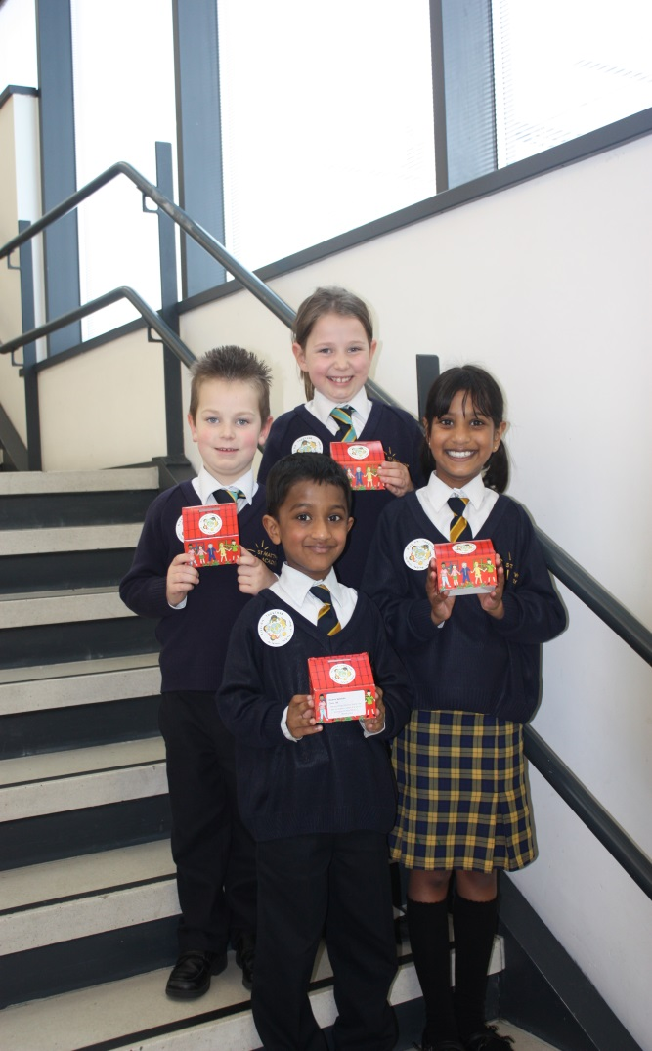
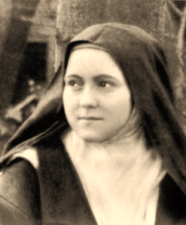
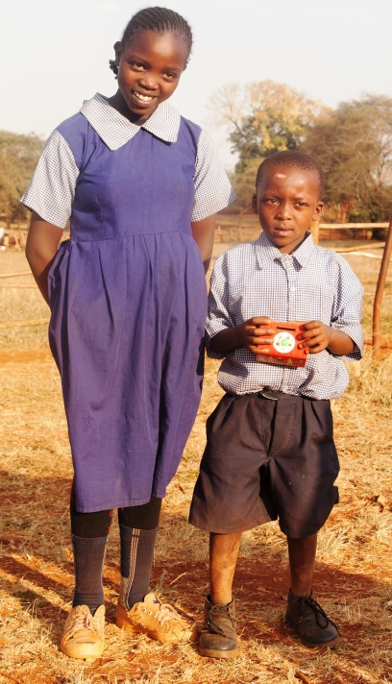
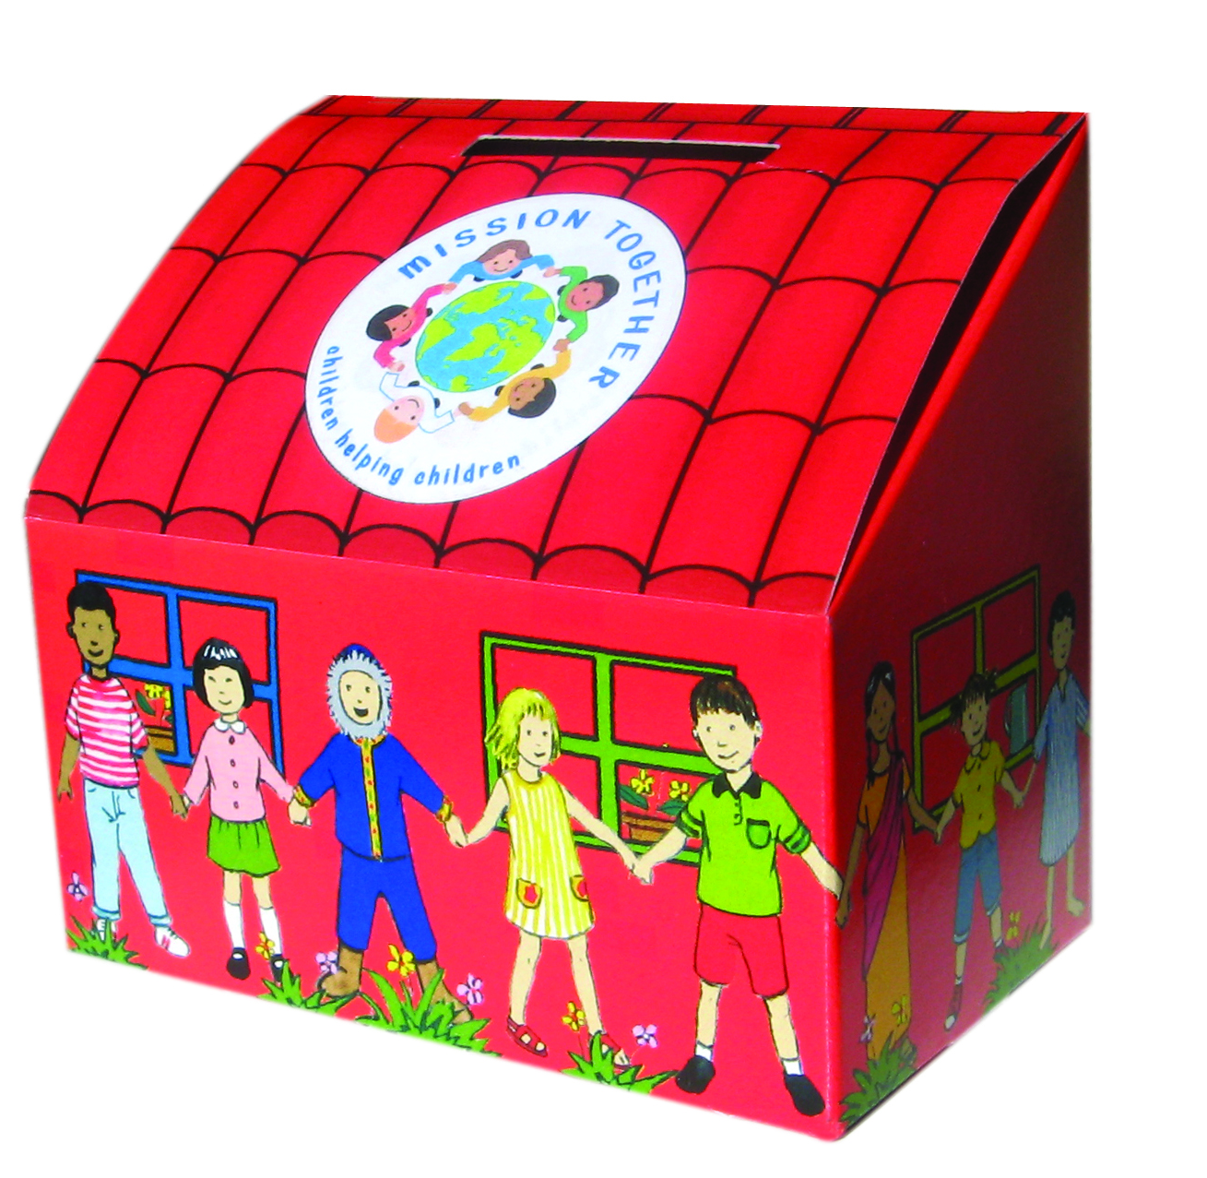
Notes:
The next time you are in church, look out for the statue of St Thérèse and remember that just because you are young or small, it doesn’t mean your actions aren’t important. You too, can follow a ‘little way’ to love and serve God and others.
This week is Little Way Week and your challenge is to try and follow St Thérèse’s example and make your own ‘little way’ to God.
What little acts of goodness and kindness can you do over the next few days?
Allow time for the children to think of some examples.
Do your chores without being asked?
Make a special effort not to give up on a school task you’re struggling with?
Decide not to argue?
Share what you have to help people around you? Perhaps you could have a Mission Together collection box in your class or at home? In this way, like Thérèse, you can also help those most in need.
Remember, it is not always easy! You will need to be very determined. But you do not have to do it alone. You can pray to God to help you, as Thérèse always did.
Because of her lifelong desire to become a missionary, St Thérèse became Patron Saint of all the Missions of the Catholic Church. Perhaps you can follow her example by praying and fundraising for Mission Together to share God’s love with children living in poverty overseas?

Slide 8
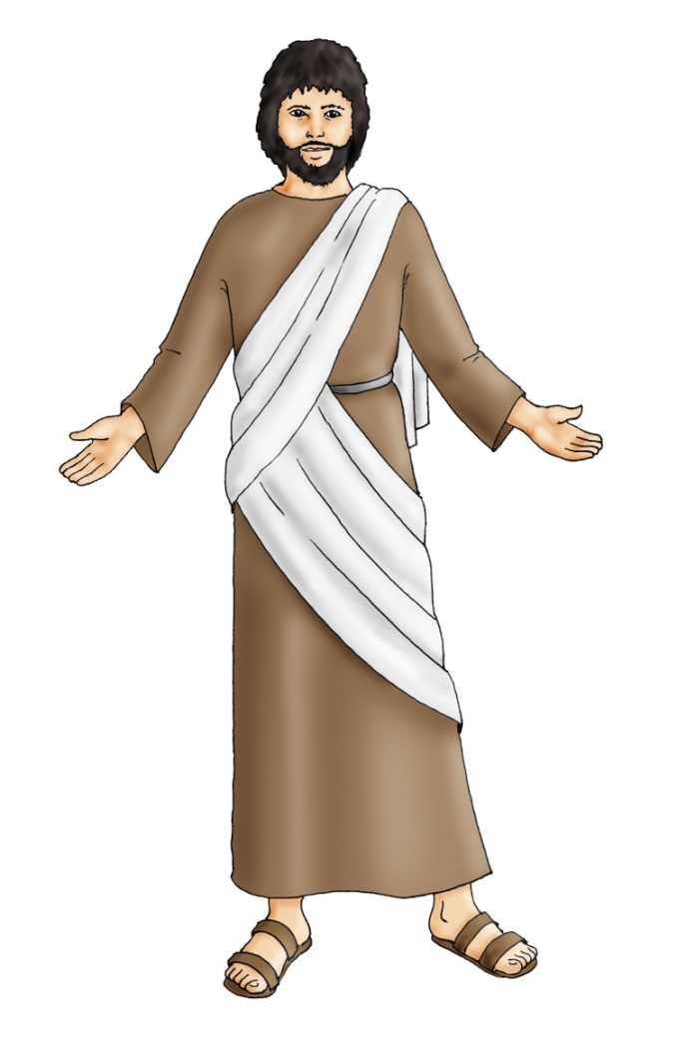
Jesus used this story to teach his followers that they should never stop praying and never lose hope.
The judge refused to help her, but she did not give up asking.
After a long time he thought to himself, “I don’t care about God or people. But this woman is bothering me. I will see she gets help or she will wear me out!”
Jesus said, “Pay attention to what the bad judge said. Now will not God, who is good and loving, help those who turn to him? I promise you, God will always give you what is right, in time.”
Luke 18: 1-7
“Once there was a judge in a town. He did not care about God or about people.
In that same town there was a woman who kept coming to this judge saying,
“There is a man who is being unfair to me. Help me to change this!”
Notes:
Suggested Scripture Reading: If there is time you may want to read - or ask a pupil to read - the parable of the Widow and the Judge (Luke 18: 1-7) in which Jesus tells the disciples to pray and never lose hope.
(The scripture is divided into three sections to make it easier to for children to read / follow. Click to reveal these sections)

Slide 9


God Our Father,
Help us to follow the example
of St Thérèse.
Like her let us never lose hope,
that we can, in our own little way,
do what is right and love others,
as you taught us.
We make this prayer
Through your Son,
Jesus Christ, Our Lord.
Amen
Notes:
Finish with the prayer on this slide. As with the scripture, you may want to ask a pupil to read this prayer aloud.
This assembly was brought to you by Mission Together, the Pope’s official children’s charity for overseas mission. If you would like to know more about Mission Together and support our important work, please visit: www.missiontogether.org.uk
Mission Together is a Catholic charity that relies entirely on public donations; it receives no funding from the UK Government
98% of money donated to Mission Together goes directly towards children's projects overseas
Mission Together works ‘Local Church to Local Church’, ensuring that money goes where the need is greatest
Donations go directly to the local bishops - this ensures that funds are distributed promptly
Local parish communities request global assistance for their project through their Bishop and must make a local contribution, be that through practical help or financial support
Mission Together respects and promotes the cultures of the people with whom we work and offers our brothers and sisters both faith and development
Mission Together welcomes feedback and suggestions on this assembly and other resources. Please contact education2@missio.org.uk

Slide 10



LITTLE WAY WEEK is offered in partnership by Mission Together, Missio,
Catholic Bishops’ Conference of England and Wales and Wednesday Word.
Notes:
Little Way Week is an initiative started by Clare Ward following the visit of the relics of St Thérèse to England and Wales in 2009.
Prayer: ©Missio
Images: Unless otherwise stated Copyright Unknown 2016

