Slide 1
The Eucharist as a sign of the Church’s Unity:
“One Bread, One Body” revisited
Fr Dominic Robinson, SJ
with ecumenical colleagues:
Revd Callan Slipper (Church of England)
Major David Evans (Salvation Army)
Revd Neil Stubbens (Methodist Church)
Canon John O’Toole (Roman Catholic Church)

Slide 2
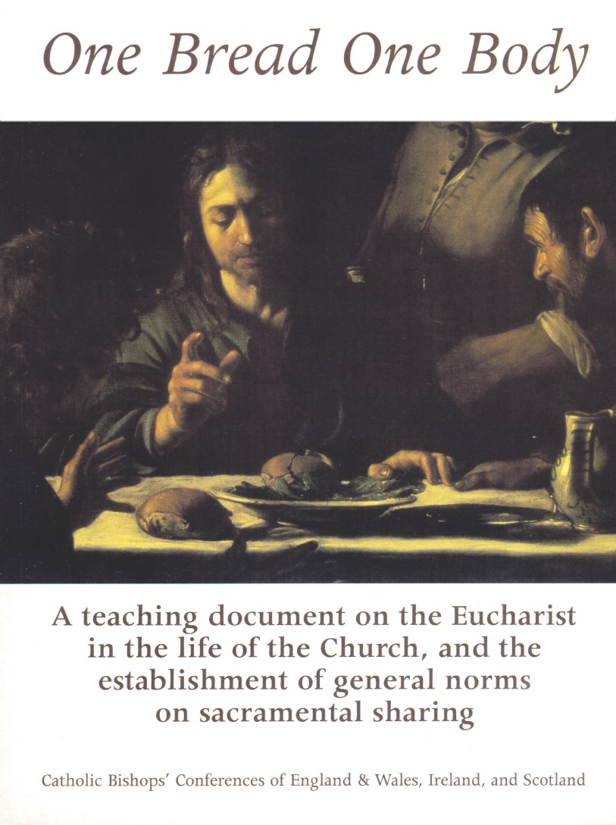
One Bread, One Body
Document of the Bishops’ Conferences of
England & Wales, Scotland & Ireland, 1998

Slide 3
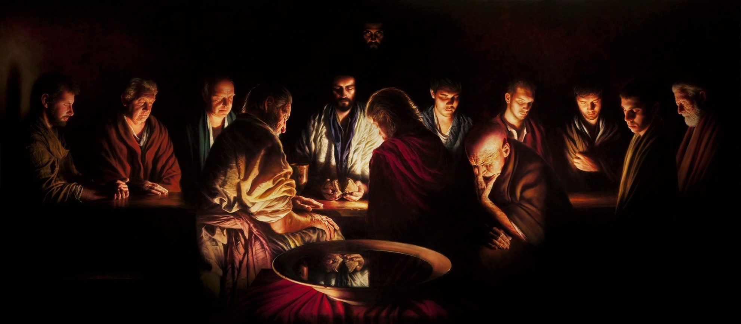
THE EUCHARIST AS
A SACRAMENT OF UNITY

Slide 4
Where are we in the painting?

Slide 5
The Lord’s Supper, not ours

Slide 6
THE UNITY OF THE ONE BODY
OF CHRIST
Preserving & deepening
Speaking the truth in love
so all may grow together into Christ

Slide 7

THE UNITY OF THE ONE BODY
OF CHRIST
Christian
UNITY

Slide 8
THE EUCHARIST UNITES US
Above all in Eucharist we become one in Christ
So no full unity without:
unity in Eucharist
shared understanding of what it contains & signifies

Slide 9
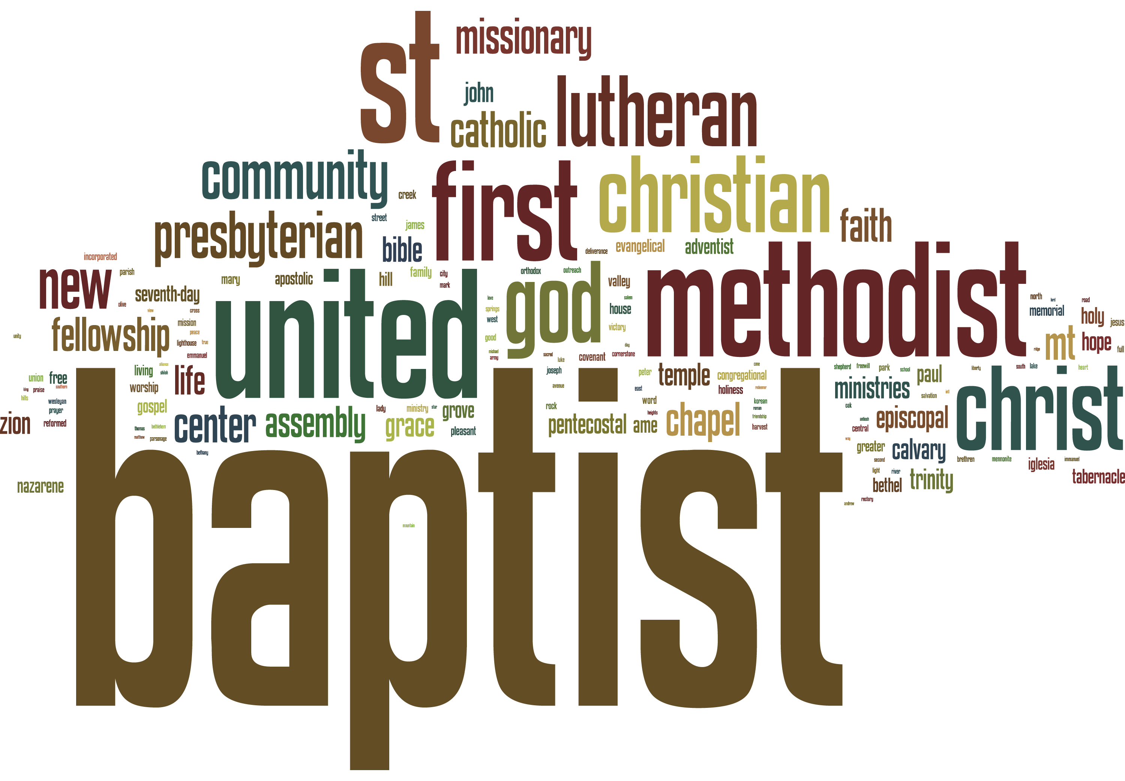
CONTEMPORARY ECUMENICAL CONTEXT

Slide 10
CONTEMPORARY ECUMENICAL CONTEXT
“Special account” of situation together:
Praying & working
Marriage
Growing agreement
“Burning desire” for unity

Slide 11
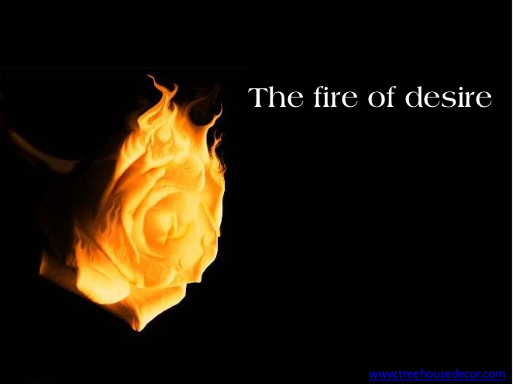
CONTEMPORARY ECUMENICAL CONTEXT

Slide 12
Called to greater:

Slide 13


Slide 14


Slide 15


Slide 16
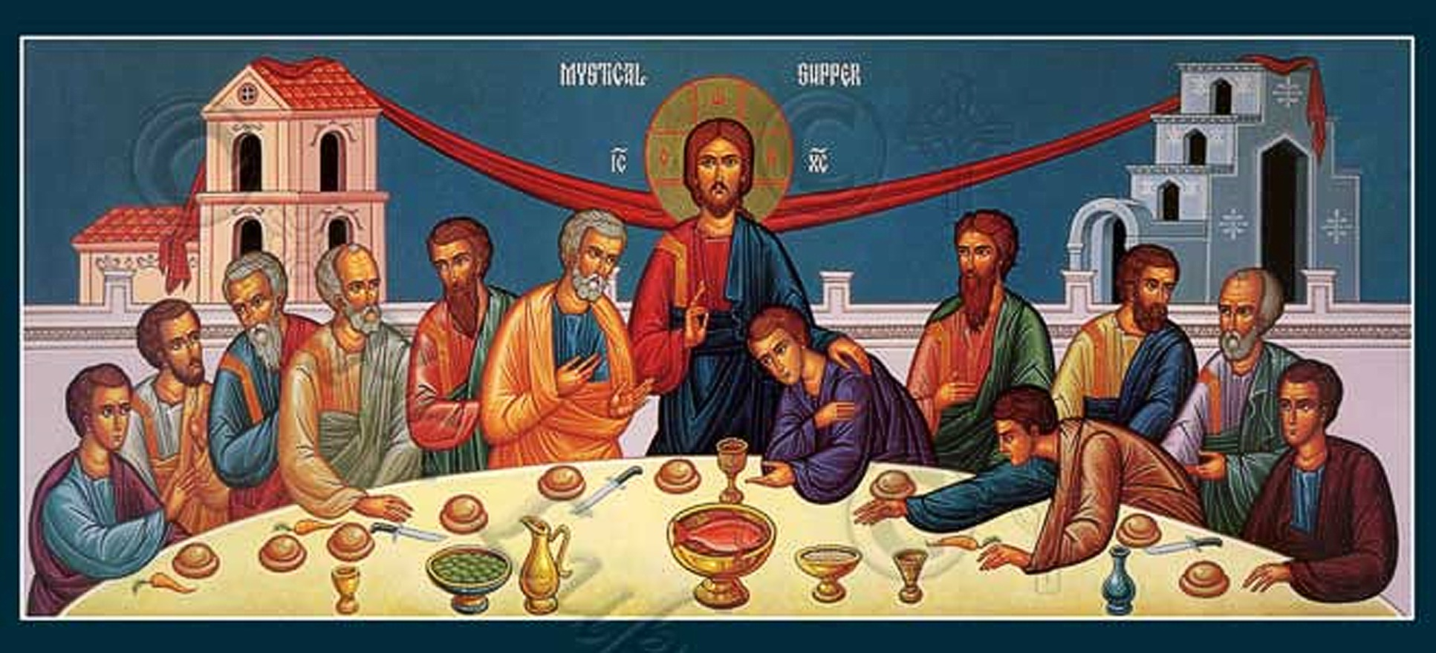
One Bread, One Body:
The Norms for Eucharistic Sharing
Copyright by Holy Transfiguration Monastery (Brookline, Massachusetts)

Slide 17
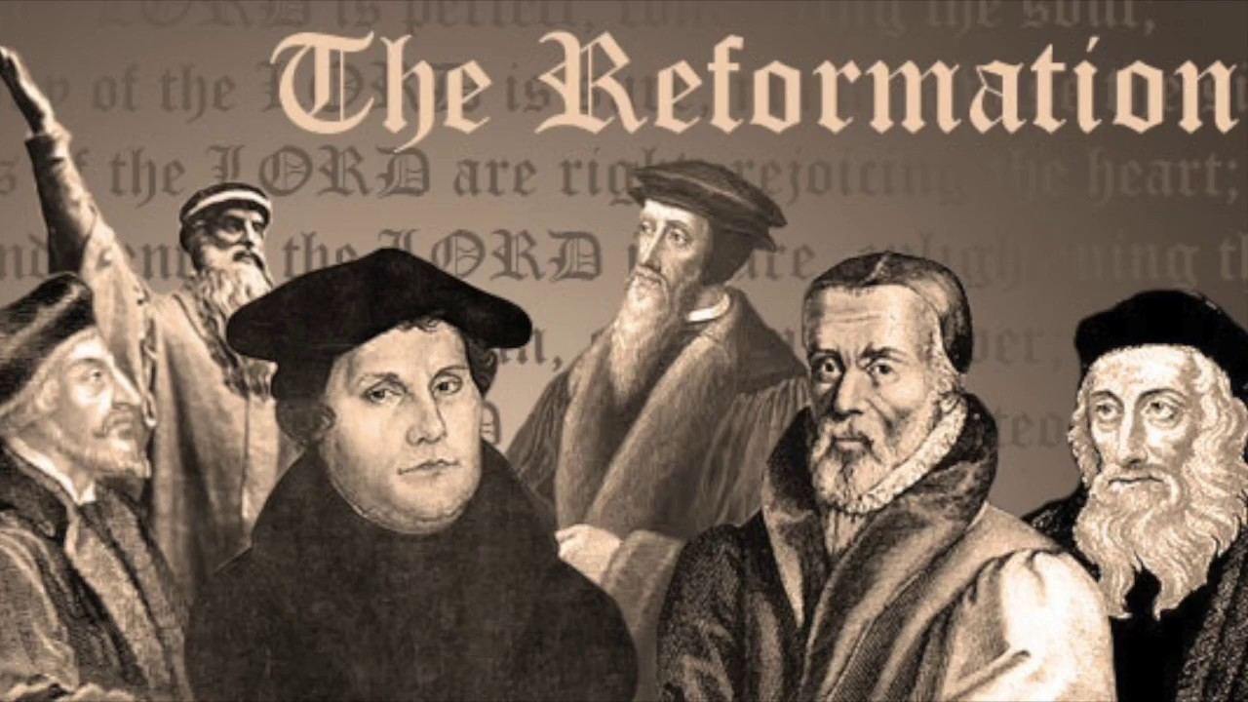
One Bread, One Body:
The Norms for Eucharistic Sharing

Slide 18
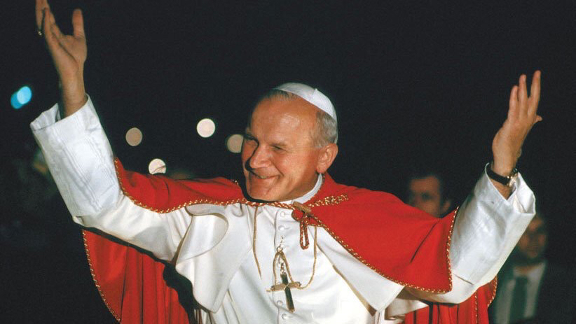
St John Paul II, Ut Unum Sint
Photo Credit: CNS photo

Slide 19
St John Paul II, Ut Unum Sint
“It is a source of joy to note that Catholic ministers are able, in certain particular cases, to administer the Sacraments of the Eucharist, Penance and Anointing of the Sick to Christians who are not in full communion with the Catholic Church but who greatly desire to receive these sacraments, freely request them and manifest the faith which the Catholic Church professes with regard to these sacraments."

Slide 20
THE TENSIONS
PAIN
BUT ARDENT DESIRE FOR UNITY

Slide 21
THE TENSIONS
REAL
AND IMPERFECT COMMUNION

Slide 22
THE CALL TO:
LISTEN TOGETHER
UNDERSTAND TOGETHER
WORK TOGETHER

Slide 23

FOR UNITY CHRIST DESIRES

Slide 24

The Revd Dr Callan Slipper (C of E)
One because made him together
The pain of disunity builds unity through the cross
Nourishing each other with the God we receive
Spiritual communion is real communion

Slide 25
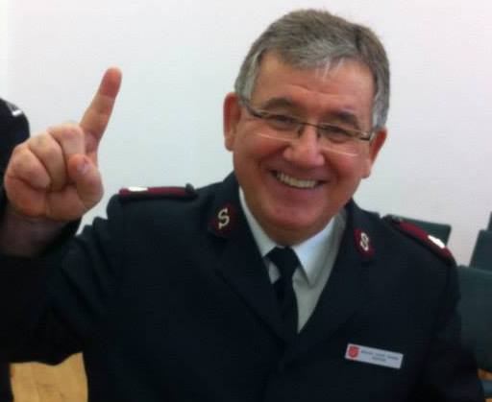

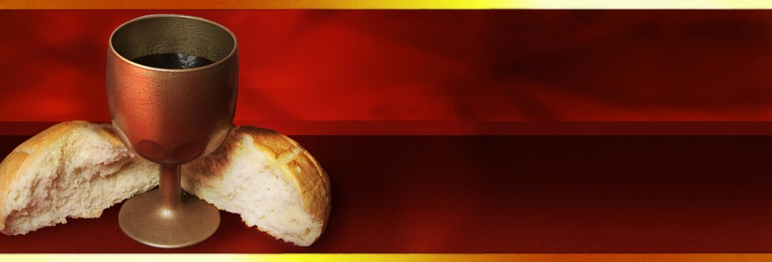
My life must be Christ’s broken bread,
My love His outpoured wine;
A cup o’erfilled, a table spread
Beneath His name and sign,
That other souls, refreshed and fed,
May share His life through mine.
Major David Evans
National Ecumenical Officer
UKI
General Albert Osborn 1947
“The goal is for all of them to become one heart and mind — Just as you, Father, are in me and I in you, So they might be one heart and mind with us. Then the world might believe that you, in fact, sent me”.
John 17:21b

Slide 26
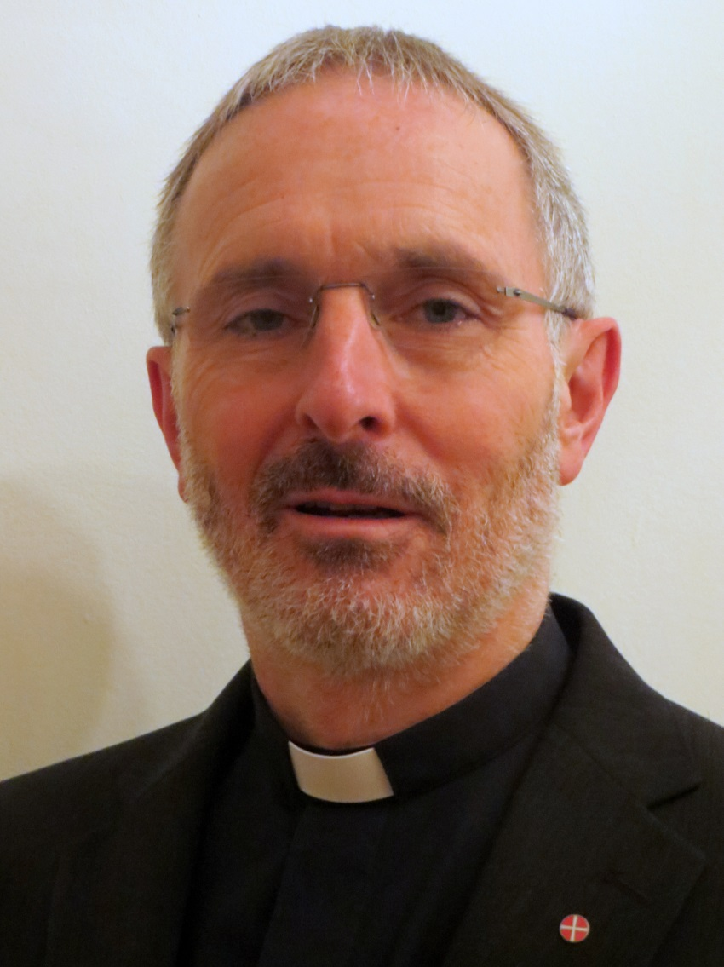
His presence makes the feast;
and now our spirits feel
the glory not to be expressed,
the joy unspeakable.
Charles Wesley (1707-88)
Revd Neil Stubbens
(Methodist Church)

Slide 27
QUESTIONS TO THE PANEL

Slide 28
One Bread, One Body
Download the Document here:
http://www.catholicchurch.org.uk/Home/News/CBCEW-Publications/One-Bread-One-Body-1998/(language)/eng-GB

Slide 29
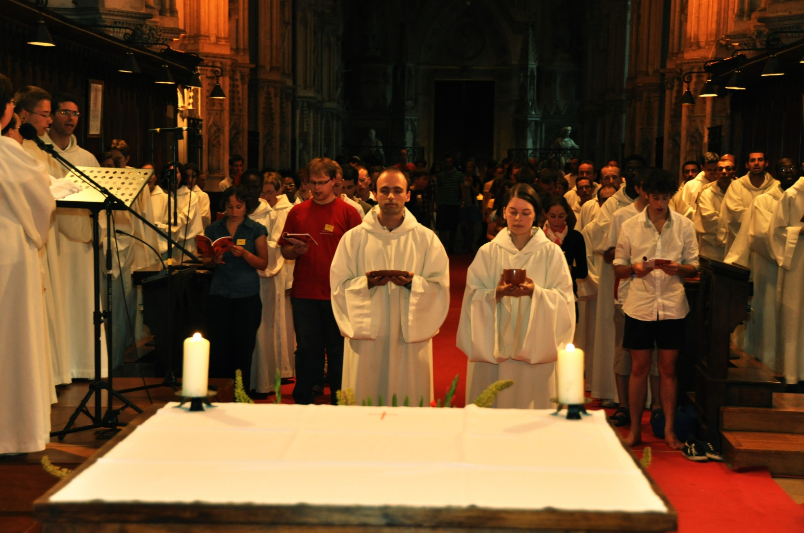

Slide 30
Lord Jesus, who prayed that we might all be one,
we pray to You for the unity of Christians,
according to Your will, according to Your means.
May Your Spirit enable us
to experience the suffering caused by division,
to see our sin,
and to hope beyond all hope. Amen.

