Slide 1
Eucharistic Liturgical Rites outside of Mass
Adoremus, Friday 7 September

Slide 2
Overview
Looking at the Rite — Martin Foster
What is holiness?— Fleur Dorrell
What is distinctive about Eucharistic Adoration?
— Fr Paul Gunter osb

Slide 3
Before we begin…
Where do you like to sit in church and why?

Slide 4
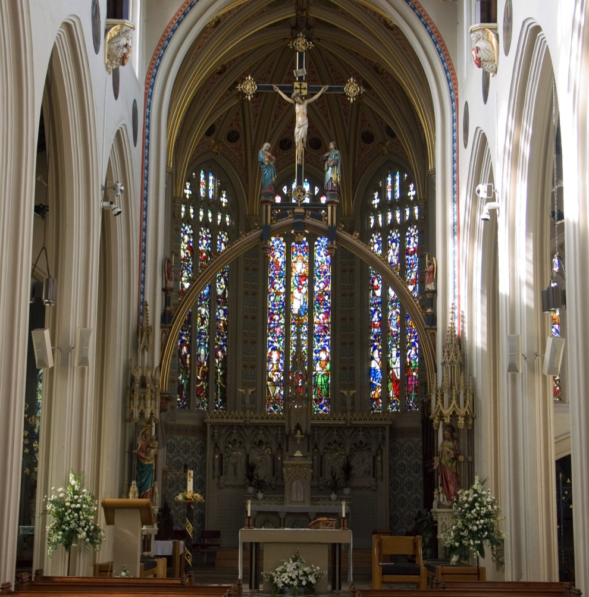
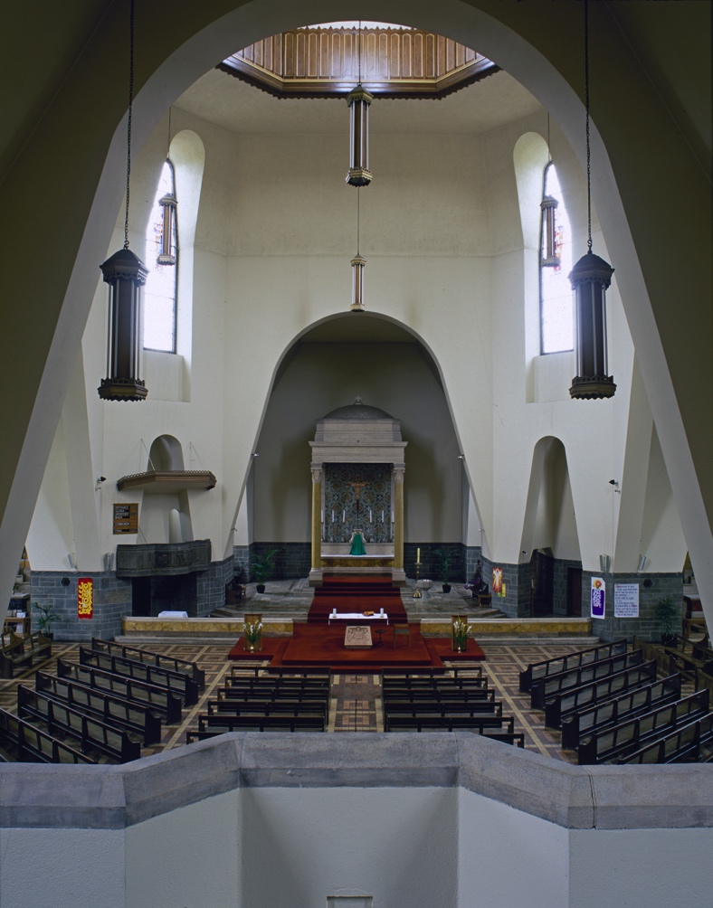

Slide 5
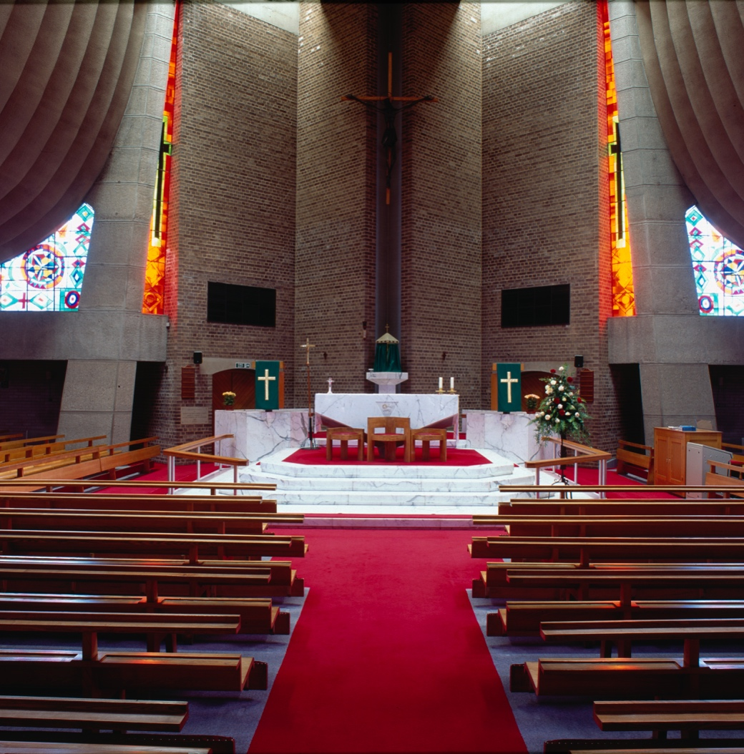
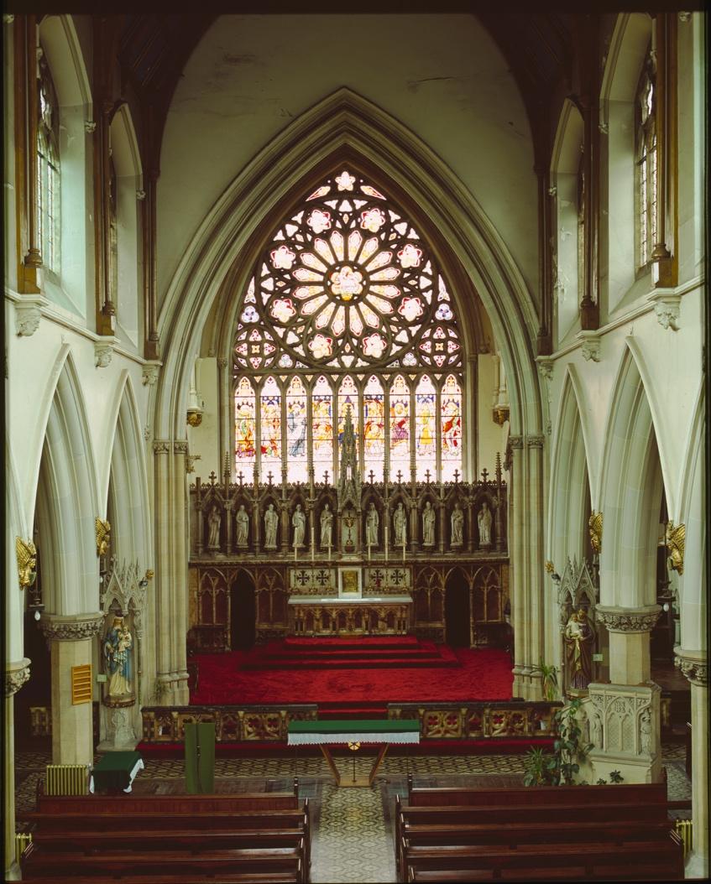

Slide 6
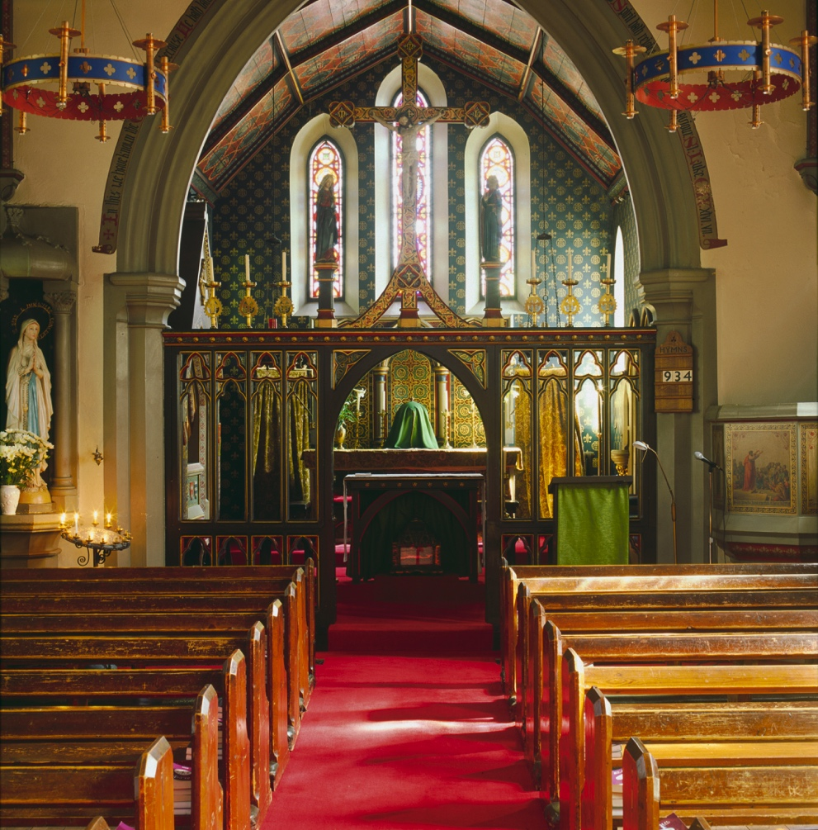
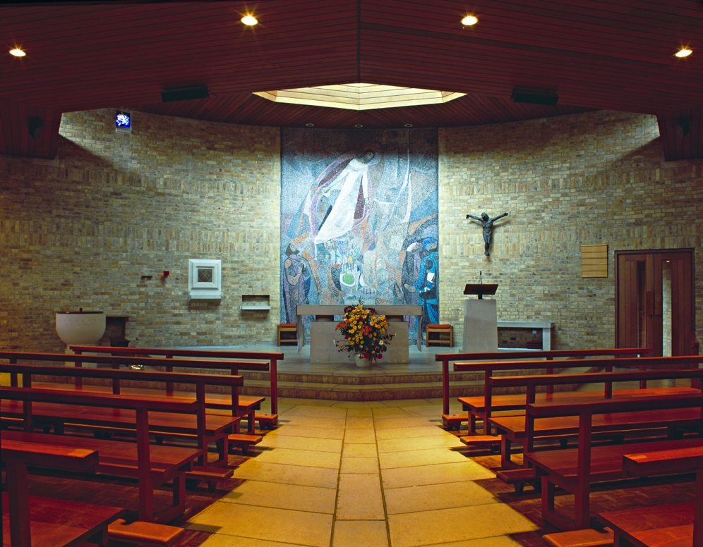

Slide 7
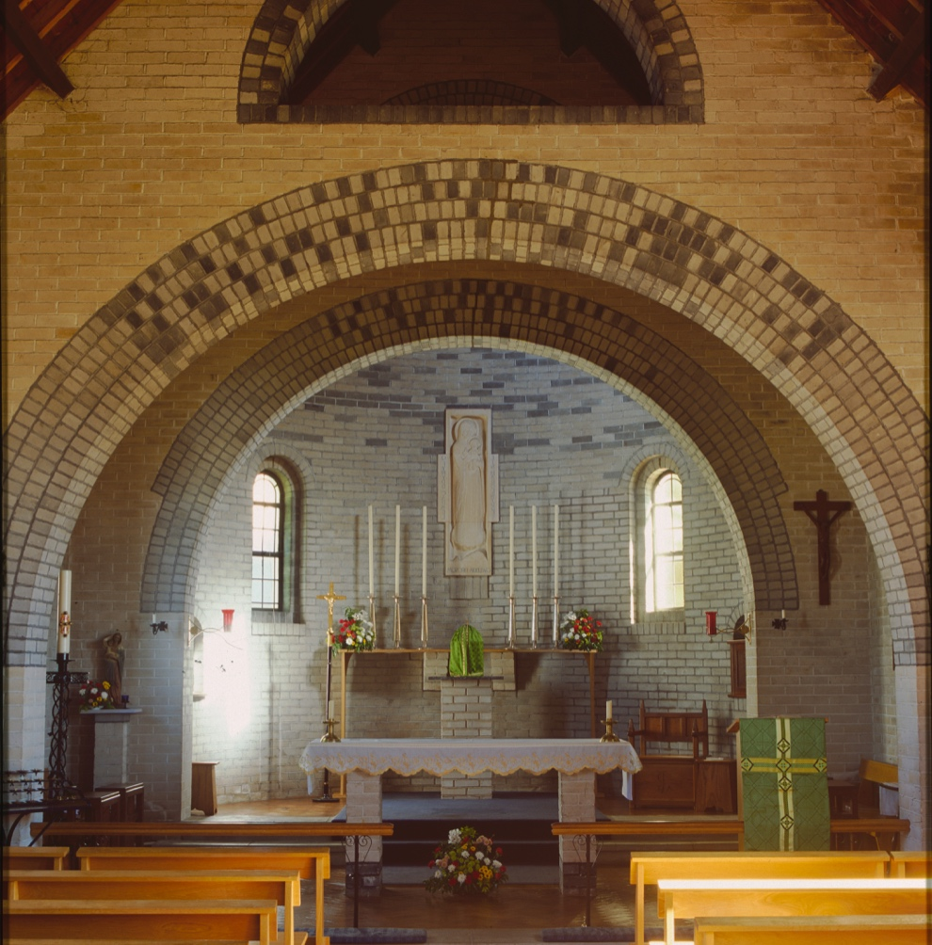
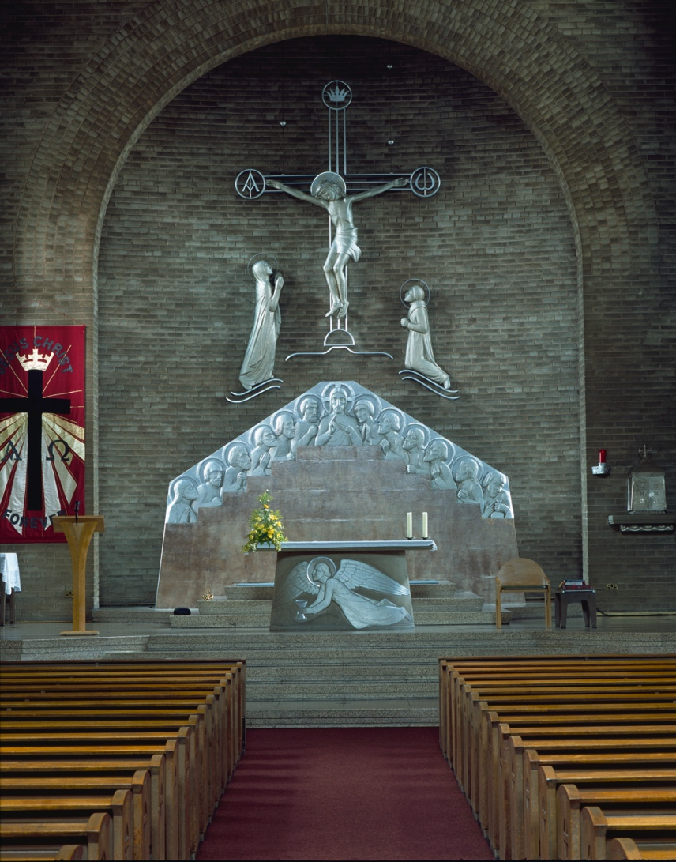

Slide 8
Looking at the Rite

Slide 9
Looking at the Rite
Holy Communion and Worship of the Eucharist outside Mass
Contents
  Rite of Distributing Holy Communion outside Mass
  Exposition of the Holy Eucharist
  Eucharistic Processions
  Eucharistic Congresses

Slide 10
Structure I
4 parts or movements
  Exposition
  Adoration
  Benediction
  Reposition

Slide 11
Structure II
Exposition
  Song
  Exposition (from place of Reservation) or
  Exposition after Mass

Slide 12
Structure III
Adoration
  Readings
  Homily
  Prayers
  Songs (etc) or
  Liturgy of the Hours
Silent prayer

Slide 13
Structure IV
Benediction
  Eucharistic Song
  Prayer
  Blessing
Reposition
  Reposition (Procession to the place of Reservation)
  Acclamation

Slide 14
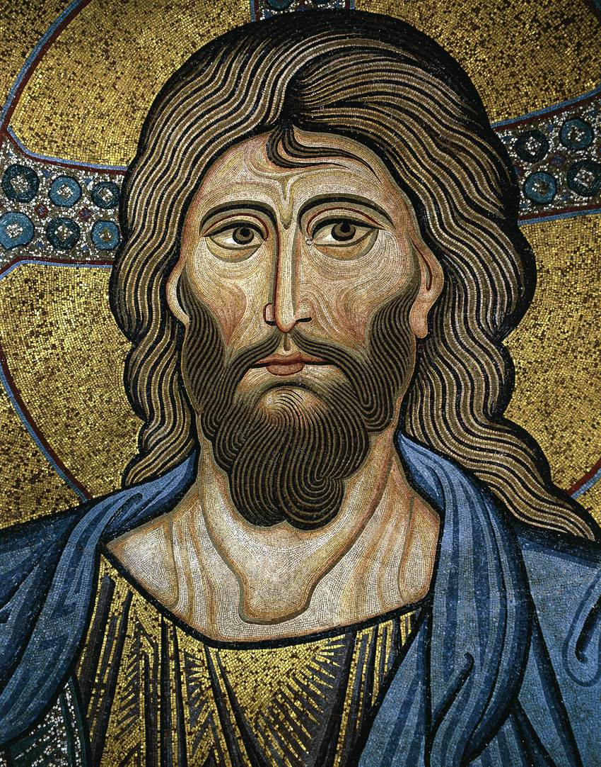
Hallmarks
Flexibility
Focused on Christ

Slide 15
A Liturgical Celebration
A range of circumstances
  Prayer before the Blessed Sacrament
  Exposition of Blessed Sacrament
  Extended Exposition
In Common
  Place of Scripture
  Silence

Slide 16
Relationship with Mass
Exterior
  The consecrated Host is the fruit of a particular Mass
  The monstrance is placed on the altar
  The same number of candles is used as at Mass

Slide 17
Relationship with Mass
Interior
  A spiral movement
  Reflection on the Eucharist
  Deepen our participation in Mass
  Receive Christ in Communion
  Live lives of holiness in faith and action

Slide 18
Resources
For further information and resources
  www.liturgyoffice.org.uk/Resources/Adoremus
Church images from A Glimpse of Heaven by Alex Ramsay

Slide 19
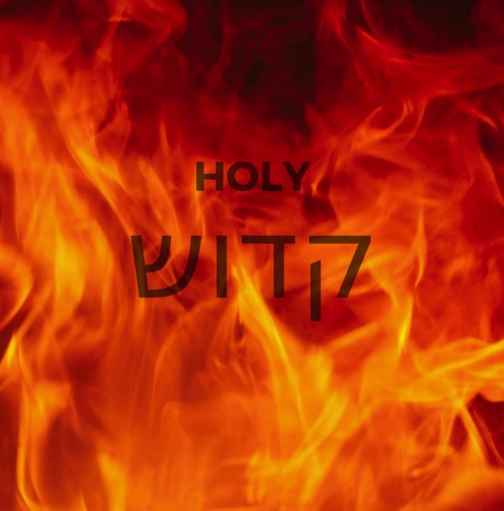
What is holiness?
Where do we find it in the Bible?

Slide 20
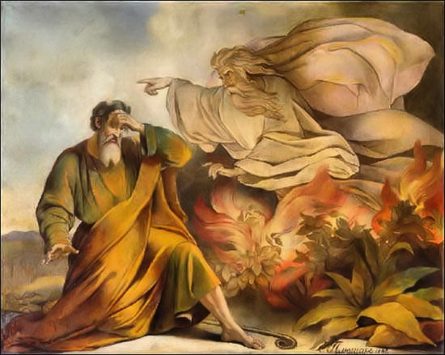
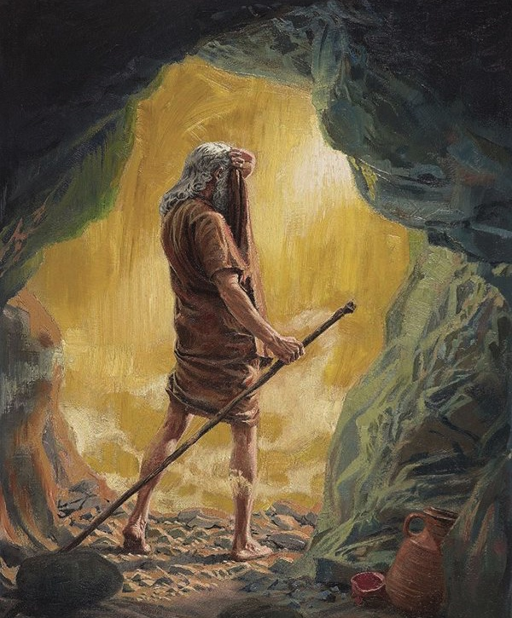
Moses and the Burning Bush. Elijah at the cave.
Both at Mount Horeb.

Slide 21
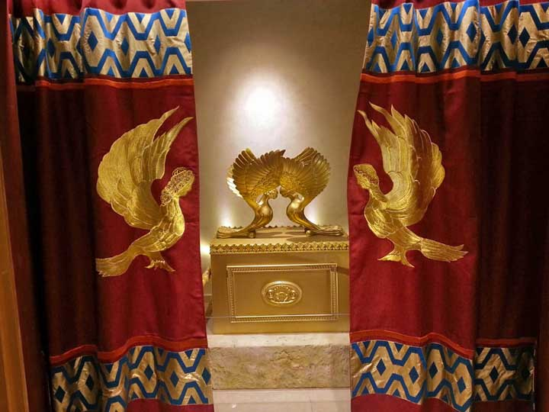
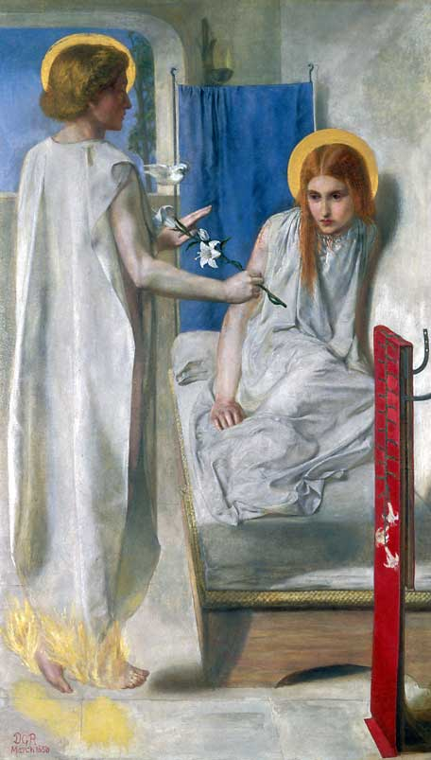
The Temple Veil tearing.
The Annunciation – Rossetti, 1850.

Slide 22
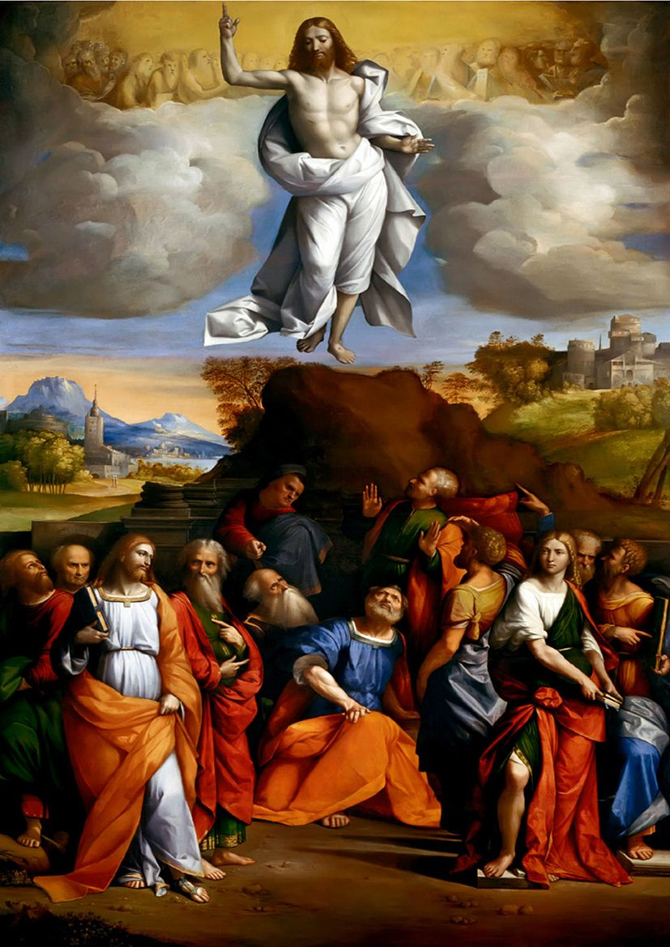
Jesus’ Ascension
at Bethany.
c. 1510-20.
Benvenuto Tisi.

Slide 23
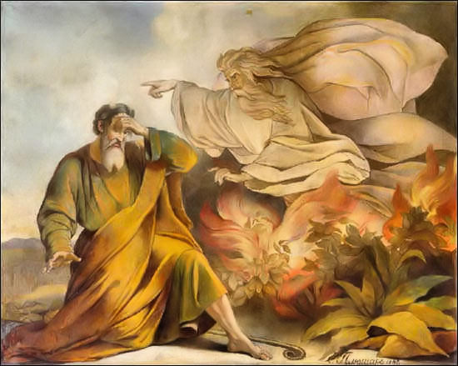
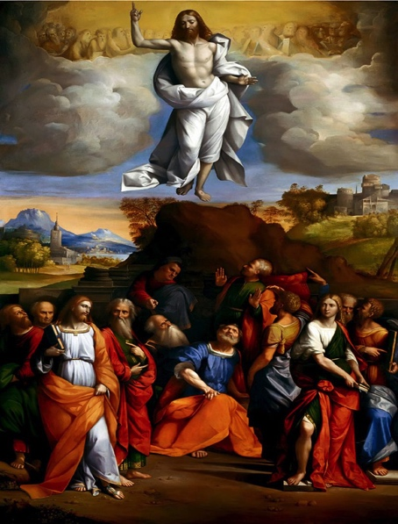
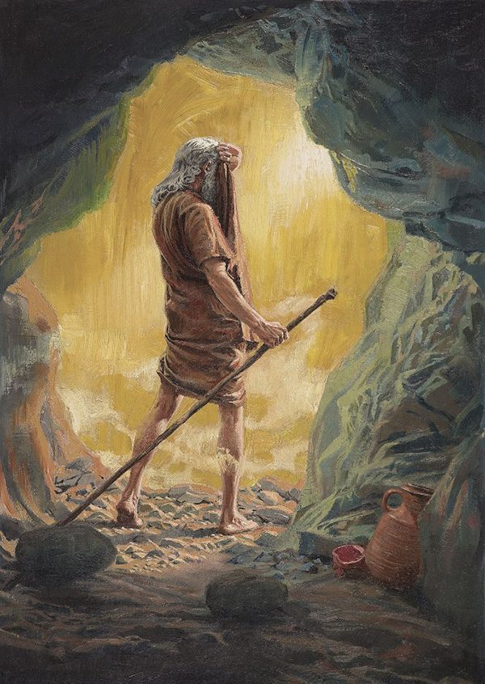

Slide 24
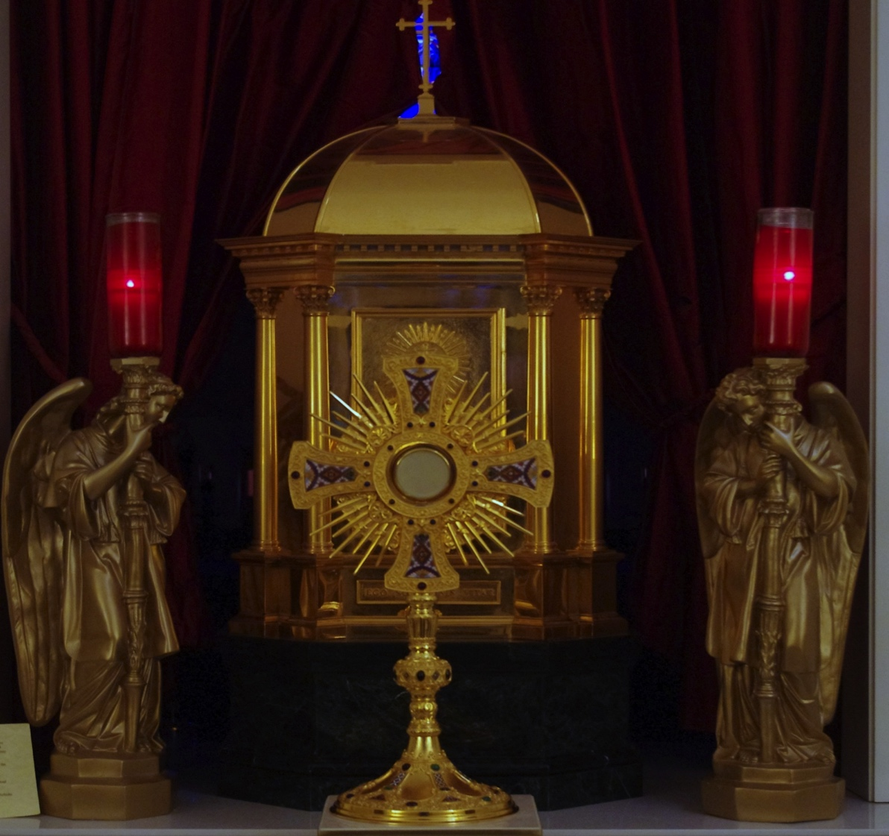

Slide 25
What is distinctive about Eucharistic Adoration?

Slide 26
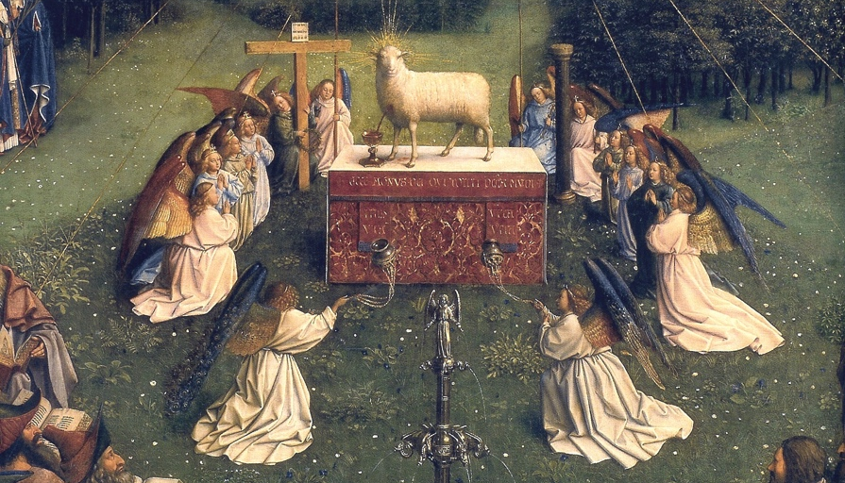
Adoration is Latreia

Slide 27
Adoration is Latreia
The Catholic Church has always displayed and still displays this latreia that ought to be paid to the Sacrament of the Eucharist, both during Mass and outside of it.
  Bl. Paul VI

Slide 28
Paschal Mystery
It can be argued that Good Friday provided the first example of the Blessed Sacrament exposed.
Eucharistic Adoration, as a prolongation of the celebration of the Paschal Mystery, insists on the final and preparatory aspects of the Eucharist, on the now and the not yet, until he comes again.

Slide 29
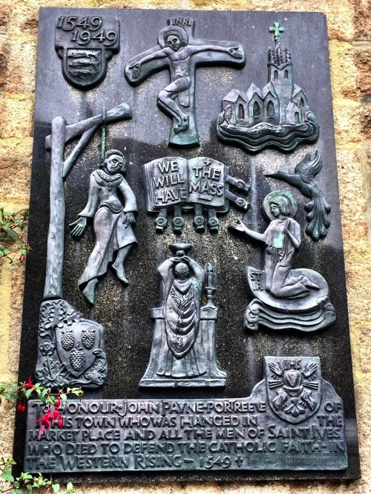
Without the celebration of the Holy Mass, we would not have the Most Holy Sacrament of the Altar to adore.

Slide 30
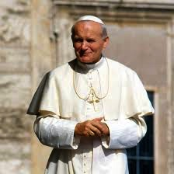
St John Paul II
The worship of the Eucharist outside of the Mass is of inestimable value for the life of the Church. This worship is strictly linked to the celebration of the Eucharistic Sacrifice.

Slide 31
Adoration & Prayer
Attention is the mother of prayer.
Personal prayer does not contradict community prayer. They feed each other.
The spiritual life is not limited solely to the Liturgy
Adoration as a personal devotion, helps create an atmosphere which feeds into liturgical prayer and inner participation.

Slide 32
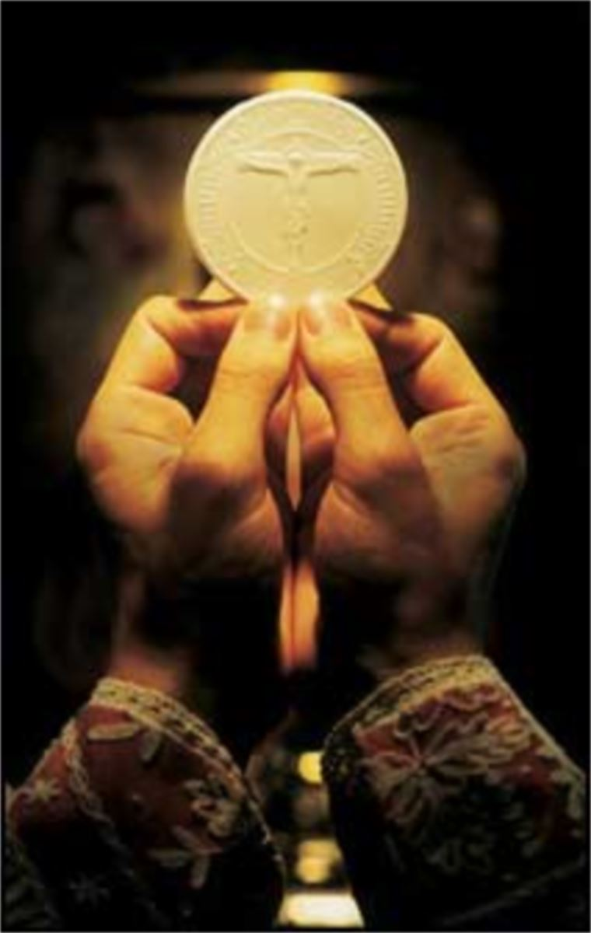

Slide 33
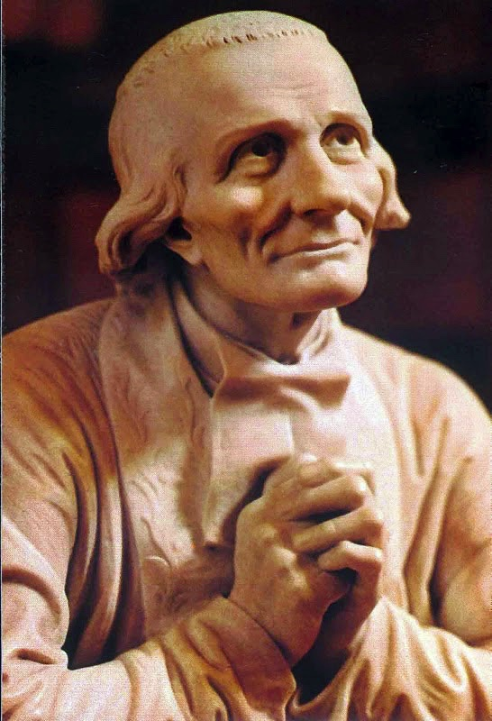
Eucharistic Adoration
& Eucharistic Contemplation
I look at him
& he looks at me.

Slide 34
Eucharistic Amazement
In contemplating Jesus in the Sacrament of the altar, we actualise the prophecy made at the moment of Jesus’ death:
  They shall look on him whom they have pierced. (Jn 19:37)
Contemplation of the Lamb slain for us will not cease. In front of the tabernacle, we form one choir with the Church in heaven; [the saints] face-to-face in the beatific vision, and we in faith.

Slide 35
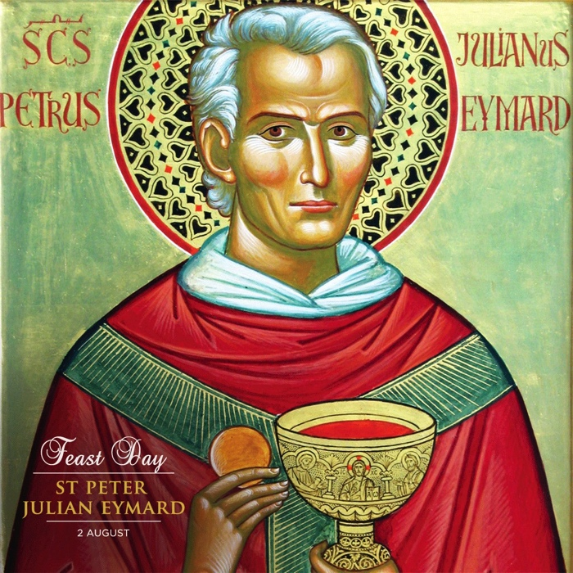
Eucharistic Amazement
The Eucharist is the supreme proof of the love of Jesus. After this, there is nothing more but heaven itself.
  St Peter Julian Eymard

Slide 36
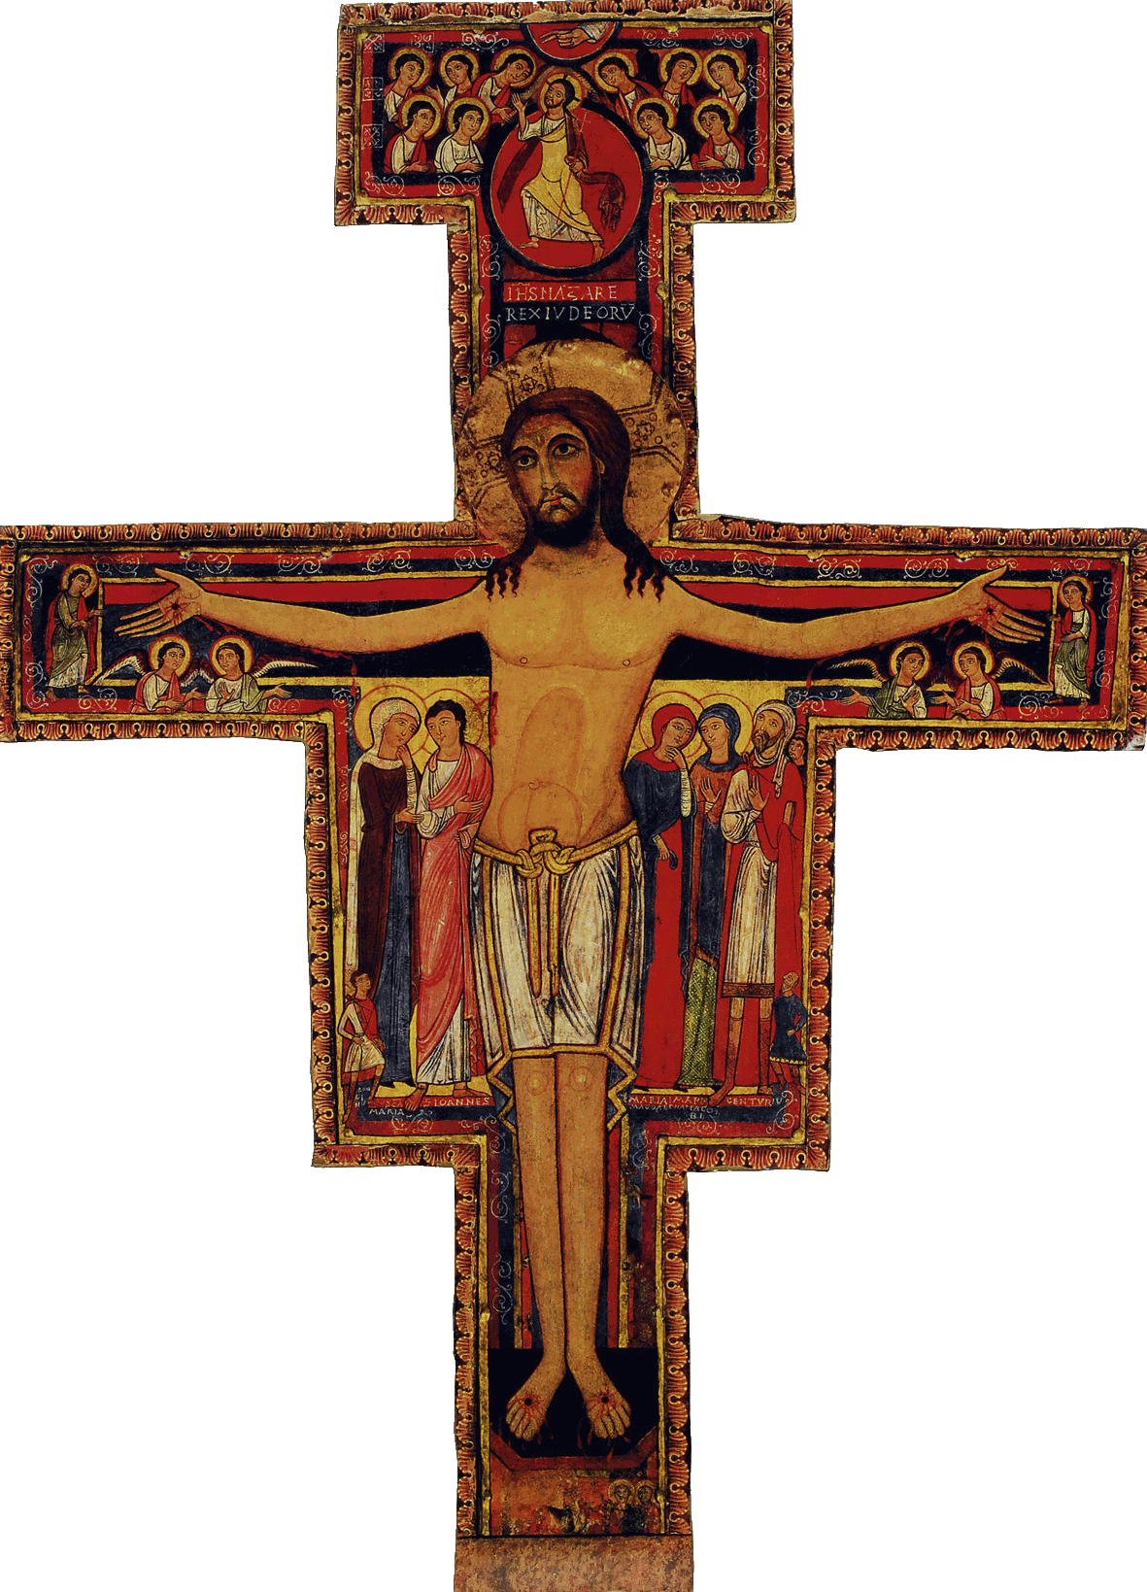
Go and rebuild my church

