Slide 1
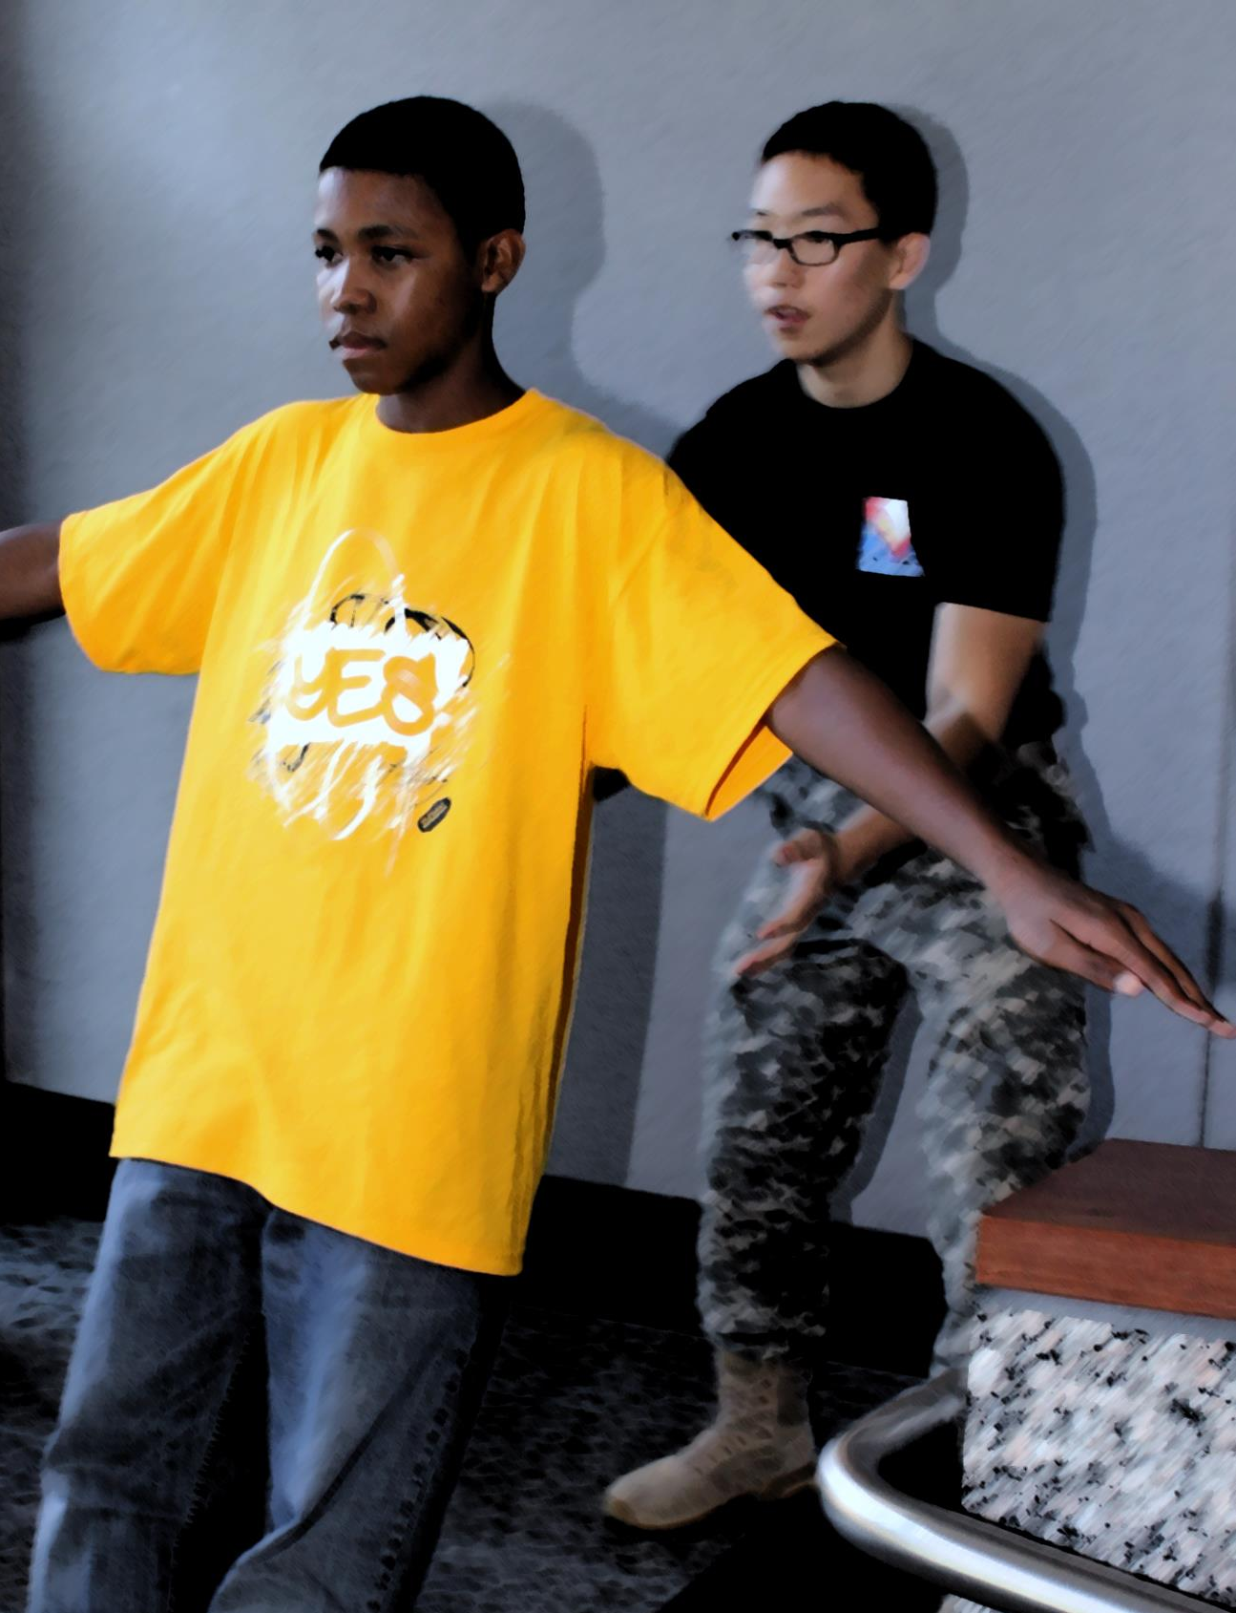
T
R
U
S
T
Notes:
Mercy Assembly
Presenter: Let’s start with a game this morning. I am going to show you an image and you are going to tell me what word it represents.
Let’s start with this one. What word do you think this image represents?
[click to reveal a letter, to give students a clue]
Trust – is the first of four words that lead us to our key theme for today.
Trust is the foundation of any relationship and is the first step on our journey this morning.
[In a large assembly, please feel free to get some volunteers to interact, perhaps representing each class/year group]

Slide 2
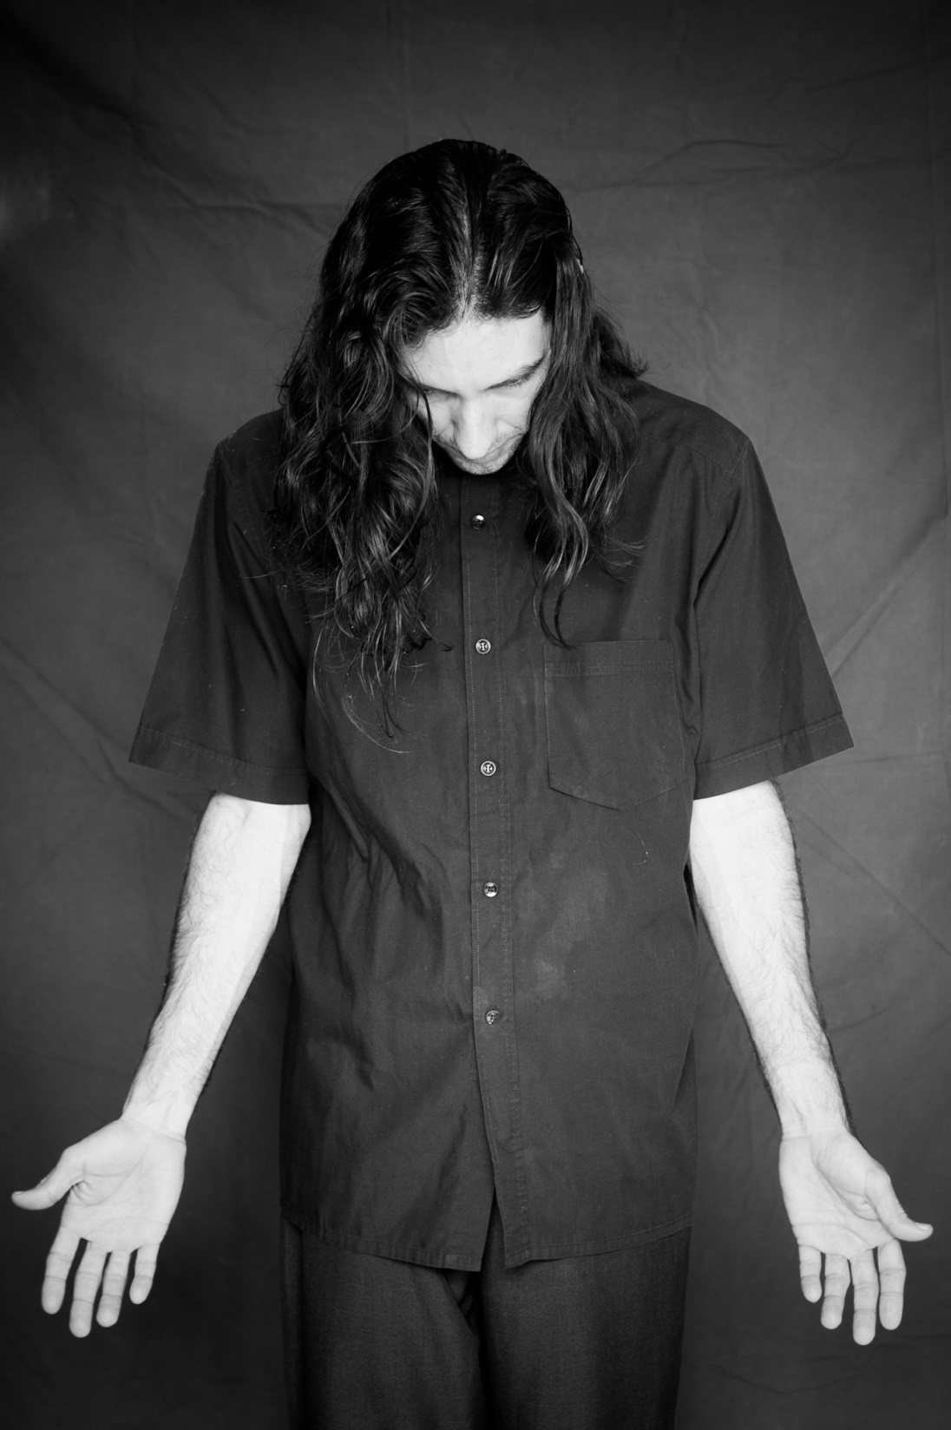
S
U
R
R
E
N
D
E
R
Notes:
What do you think this man is trying to show us?
[Click to reveal the word ‘surrender’ – it will appear letter by letter]
Someone who surrenders is being honest about their needs and seeks help. Perhaps it can seem like a weak thing to do, but when we see someone on TV whose life is threatened and surrender, their life is saved in that moment.
Image: Escael Marrero; Surrender

Slide 3

B
E
L
I
E
V
E
Notes:
Why does this person need to walk the tight rope?
[Click to reveal the word ‘believe’ – it will appear letter by letter]
She needs to believe in a number of things to even consider taking that first step. For example she needs to believe in the strength of the string, the trees which it is attached to, her balance and even her ability to stay focussed.
How easy do you find it to believe and take a step of faith?
Image: https://ruach.files.wordpress.com/2011/11/walking-on-the-roap-by-esperantista.jpg

Slide 4
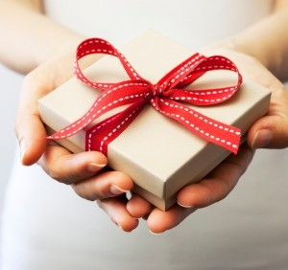
R
E
C
E
I
V
E
Notes:
[Click to reveal the word ‘receive’ – it will appear letter by letter]
Apart from a gift what else might a person ‘receive’?
Before mobile phones, people would have talked about ‘receiving a telephone call’. Has anyone received an email? A facebook message, a text, a visitor?
All we need to do is to take a moment to welcome the message, call or person into our lives and see what they have to offer.
Image:http://laurarafferty.com/wp-content/uploads/2014/12/gift.jpg

Slide 5




Notes:
[click for the images to appear] Each of the words we have discovered lead us on a journey and help us to open the door of our hearts to receive a special guest.

Slide 6
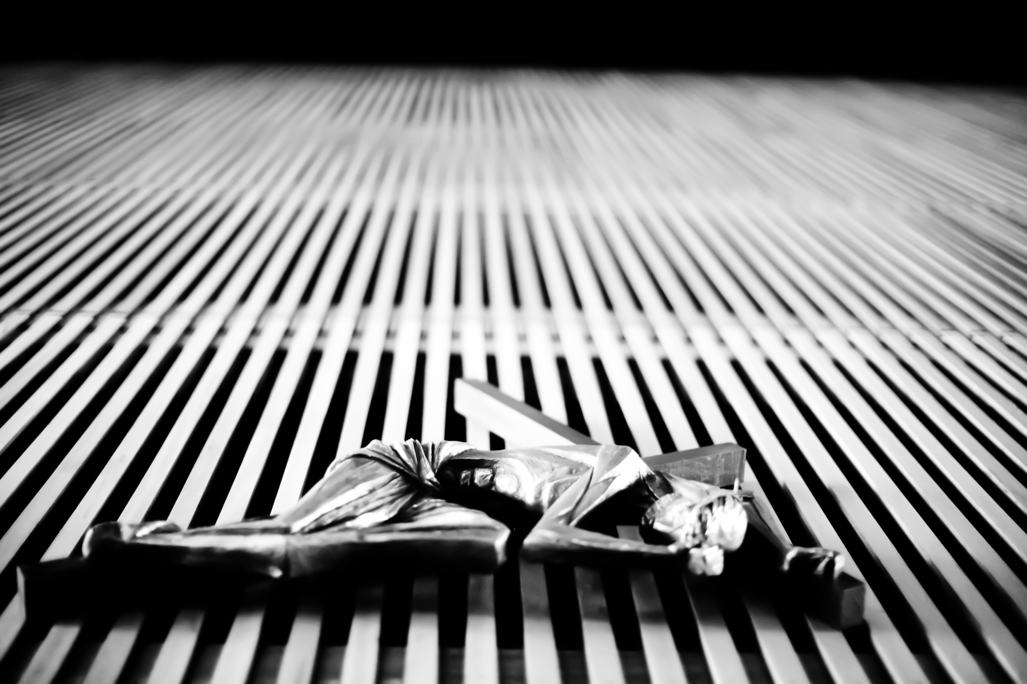
MERCY
Notes:
Jesus – he is the face of God’s Mercy [click for mercy to appear]
and he knocks on the door of each person’s heart.
But what is Mercy? Simply put, Mercy is love in action.
God looks at us and notices what we most need and loves us enough to give it to us.
Image source: The suffering of Jesus
https://www.flickr.com/photos/thomashawk/12982350534/in/photolist-kMcWvU-pHGZpV-HEjq5n-H3ewLC-HRyihW-GSX2jC-HwKEFJ-HL5SLu-HCA9yx-JDD8qm-FEjQyG-HsfL5V-fdbqoL-Jp5jef-FLoRZU-FG6zmG-pW7bT5-oLb91U-r1tQLq-JnhVEs-GMQYZt-pXPTHH-8nnv7V-HJwHsk-bHKwSz-JGUhKu-HGjHQL-r1vfHA-emYsTq-btzHTq-pKbWxK-GXs1wo-ndQxwB-GJi86w-JxqKHX-99Ra4S-pfBVky-pAT7EJ-pywh5P-6TXqFd-pSAKEf-3NqE8T-GZFavg-HUxJQ1-r119yP-pW8Tz5-at9LJD-JqxNTJ-8gLyR8-JtPEix

Slide 7
What would help you trust Jesus more?
Trust in the Lord with all your heart and lean not on your own understanding; in all your ways submit to him, and he will make your paths straight.
Proverbs 3:5
Notes:
God does not watch our lives from a distance but invites us to lean on him, to trust. [click to reveal the Bible passage]
[Read the Bible passage]

Slide 8
What do you need help with?
Your kingdom come,
Your will be done,
on earth as it is in heaven.
Matthew 6:10
Notes:
It is easy to think we need to manage everything by ourselves, but Jesus taught us these words [click to reveal the Bible passage] ‘Thy kingdom come, thy will be done on earth as it is in heaven’ in the Our Father because only God knows how to provide the help we most need and make ‘earth as it is in heaven’.
When I say to God ‘Thy will be done’ instead of ‘My will be done’ we are inviting heaven to earth, starting with me.

Slide 9
I do believe;
help me overcome my unbelief!
Mark 9:24
What would help me to take a step of faith and believe?
Notes:
Jesus is not asking us to understand everything before he invites us to be his friend, but to believe in him. Think of someone you believe in. Do you know them completely? Often we have only scratched the surface of the people we believe in, but have started to trust and rely on them.
[click to reveal the Bible passage] It is by beginning to believe in him that he can help us with the things we find difficult to believe.

Slide 10
For everyone who asks receives; the one who seeks finds;
and to the one who knocks,
the door will be opened.
Matthew 7:8
Are you ready to receive the love Jesus offers?
Notes:
[click to reveal Bible passage and read it out]
Don’t take my word for it, invite Jesus into your heart – receive his love for yourself.

Slide 11
Blessed are the Merciful for they shall receive Mercy.
Matthew 5:7
Truly I tell you, just as you did it to one of the least of these who are members of my family,
you did it to me.
Luke 6:37
..and forgive us our trespasses,
as we forgive those who trespass against us.
Luke 11:4
Notes:
His love is not harsh or demanding, but merciful. It gets to the root of the matter and starts with the things that block us from knowing him. This is why Jesus teaches us to pray [click for first passage].
He starts with forgiveness and then invites us to go beyond it to reach out to others [click for the second passage]. Even if we are not sure of how to ask God for mercy, by being merciful to others we too can receive God’s mercy. So how can we be merciful?
[click for the third passage] Jesus asks us to notice the needs of the people around us and help them.

Slide 12
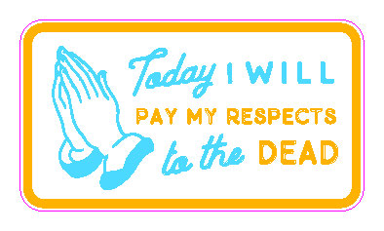





Notes:
Here are six practical ways that we can be merciful to other people – today.
Do any of them seem impossible?
[invite responses and if you have time invite other students to suggest how to show mercy in that situation]

Slide 13




‘Be still and know
that I am God.’
Notes:
Play the song linked to the title of this slide and ask the students to listen and invite Jesus into their hearts – in their own time.
https://soundcloud.com/fridaythe12th/emmaus-trust-surrender-believe
[click to show the four words]
At the end of the song you may want to finish with the following prayer:
Dear Jesus,
We bring you the prayer’s of our heart – help us to trust, to surrender, to believe and to receive your love and to show it to others through being merciful.
Lord in your mercy – hear our prayer.

Slide 14


Sunday 20th November 2016
[Please insert information about how your school or a local parish is inviting young people to be at the heart of this celebration]
Notes:
Acknowledgements
Images taken from www.flickr.com

