Slide 1

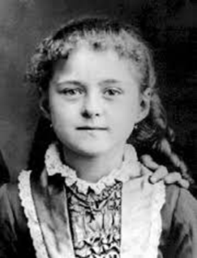


St Thérèse of Lisieux
Notes:
Ask the children if they know who this little girl is. Her name is Thérèse Martin.
She looks like an ordinary little girl; doesn’t she? She lived over one hundred years ago in France and she led a very ordinary life - probably not much different to how the children live their lives now.
She played with her four older sisters, went to the local school and enjoyed walks in the countryside with her family. They went to Mass every Sunday. They read the Bible together and prayed together as a family. They gave money to the poor and prayed for and sent money to priests and religious sisters caring for people around the world so that they might know of God’s great love.
But she was not an ordinary little girl! Thérèse went on to become one of the most famous saints of modern times.

Slide 2
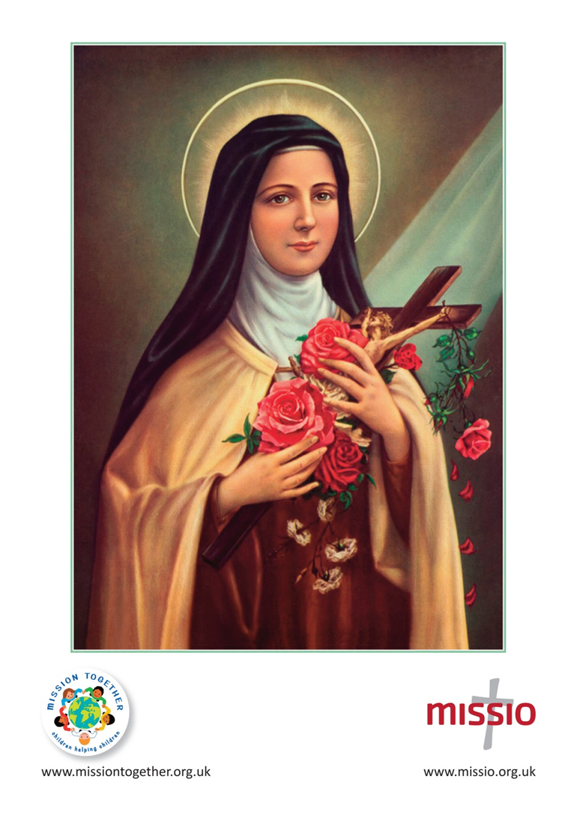
Notes:
We know her better as St Thérèse of Lisieux.
She is the patron saint of Mission and her statue is seen in churches all over the world. Mission for the Church means sharing God’s life and love with everyone all over the world by being loving and caring, just like Jesus.
Thérèse wanted to do amazing things for God - like travelling the world to show love and to care for the very poor and hungry.
But she never did go overseas to show people what Jesus is like! Instead, she lived her whole life in France and, even then, some of that time was in a convent where she chose to be shut away in prayer and doing every-day chores.
She had to find a different way to get to Heaven- little by little - and that is what we are going to think about this week and try to copy.
This is what Thérèse called her Little Way.

Slide 3

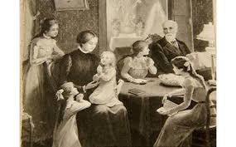


Notes:
Her mummy and daddy and her big sisters loved Thérèse very much. In fact, because she was the baby of the family, she was their favourite. Her parents mollycoddled her and her older sisters made a fuss of her.
Little Thérèse was very stubborn- she liked to get her own way and when she didn’t she became very cross!
Do the children ever feel like that?
Thérèse was very sensitive and was not physically strong. She easily became upset when someone said something hurtful and as she was often ill she spent long periods of time alone.
During these long times alone she spoke to Jesus and they became good friends.

Slide 4
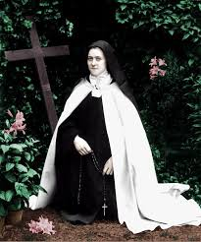

Notes:
At 15 years old Thérèse became a religious sister and joined a convent. Her life became one of love and service.
Soon she realised that she was never going to do anything extraordinary and that God’s plan for her was different to the one she had planned for herself!
She realised she would need to find another way to do something great for God.
Thérèse made a commitment to do her small everyday tasks with great love.
It was such a humble, quiet way of acting that not everybody noticed what she was doing.

Slide 5
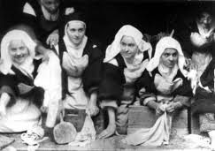

Notes:
When one of her fellow religious sisters in the convent was too rough when they washed the sheets together and splashed the dirty water on her face, Thérèse decided to say nothing. Here she is in the laundry room, second from the left.
She found one of the other sisters particularly annoying but she chose to keep silent and the sister never knew how Thérèse felt about her!
Do the children think that was easy? Remember Thérèse was very stubborn and liked to get her own way!
No! It certainly was not easy. She had to make a big effort to be loving and to put other people’s feelings before her own.
This simple way of doing small actions with great love is what Thérèse called her Little Way.

Slide 6
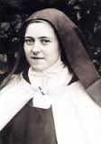
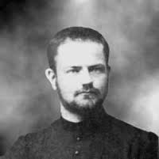
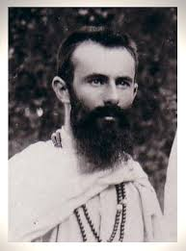
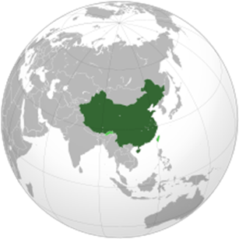
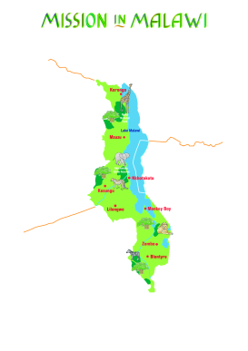
Notes:
Thérèse realised that she could not follow her Little Way alone. She needed help from her friend, Jesus.
So she prayed to him often to help her to always make loving choices.
As well as this, she never forgot her dream for Jesus to be loved all over the world so, as well as being thoughtful to those living near her, she thought of people living far away. She also prayed for the men and women who had travelled the world to make Jesus known.
Here are photographs of two priests she was asked to write to and to pray for. They went overseas to share God’s love - Father Roulland (on the left) who went to China and Father Bellière (on the right) who went to Malawi in Africa.

Slide 7
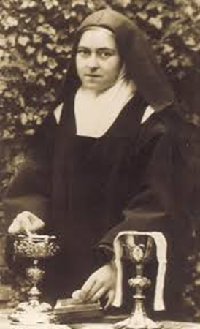

Notes:
The Little Way is very simple but it is not as easy to do as it sounds! That is why Thérèse Martin has become Saint Thérèse.
Ask the children to shut their eyes and quietly in their heads think about two things they can do this week to follow St Thérèse’s Little Way.
1. A small action done with love - suggestions may be: sharing with a sibling when they do not want to, turning off the computer as soon as they are asked, helping to do a chore at home they do
not like doing such as taking out the rubbish or helping to wash up.
Remind them that they are to do the action with love and kindness- there is to be no moaning, no boasting and no fuss!
And
2. Say a prayer to Jesus for him to be made known around the world.
Suggest that as a class they may like to say the Mission Together Prayer everyday for children everywhere.

Slide 8

Notes:
St Thérèse stayed very close to Jesus. She knew what he said about acting with humility. Her Little Way was so simple that many people did not know what a struggle it was for her, or even that she was doing anything at all!
She did what Jesus has taught us when he said,
‘When you do a good deed, your left hand must not know what your right is doing; your good deeds must be unseen and your Father who sees everything will reward you.’
Matthew 6:3

Slide 9
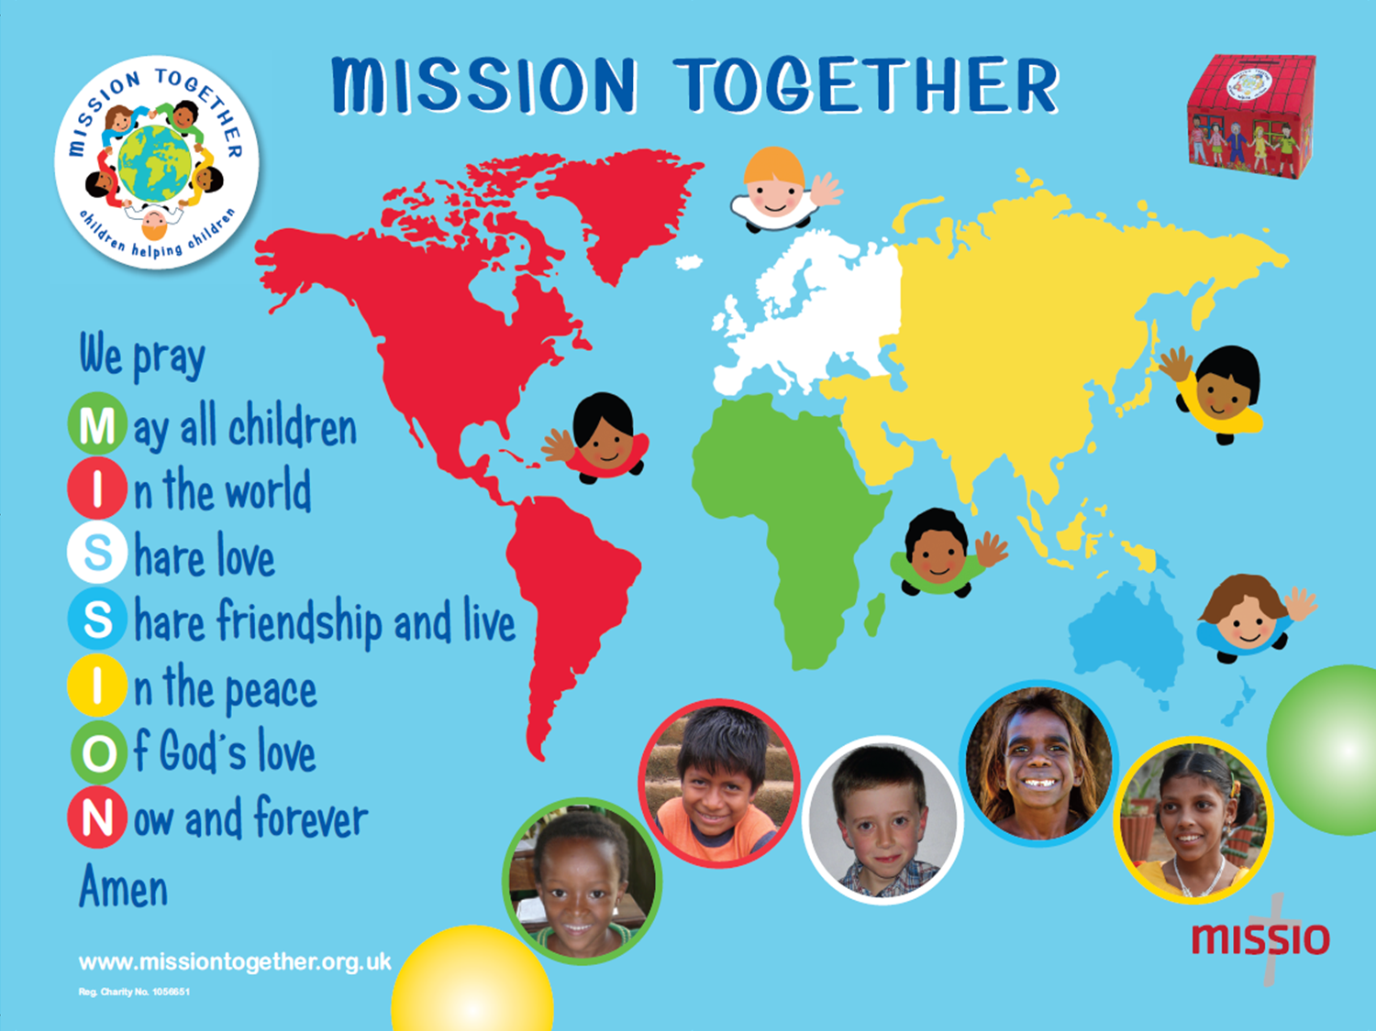
Notes:
Through loving and serving in her Little Way, St Thérèse has become the patron saint of Mission of the Catholic Church.
You may conclude by saying together The Mission Together Prayer (please see the slide.)
If you would like to know more about Mission Together, the children’s branch of Missio, the Pope’s official charity for overseas mission, then please go to its website: www.missiontogether.org.uk
Images: Copyright Unknown 2014

Slide 10



LITTLE WAY WEEK is offered in partnership by Mission Together, Home Mission Desk (Catholic Bishops’ Conference of England and Wales) and Wednesday Word.
For additional materials please see: www.catholicnews.org.uk/little-way-week
Notes:
LITTLE WAY WEEK is offered in partnership by Mission Together, Home Mission Desk (Catholic Bishops’ Conference of England and Wales) and Wednesday Word.
For additional materials please see: www.catholicnews.org.uk/little-way-week
This resourced is copyrighted.

