Slide 1
“You are God’s work of art, created in Christ Jesus to live the good life as from the beginning he has meant you to live it.”
Ephesians 2:10

Slide 2
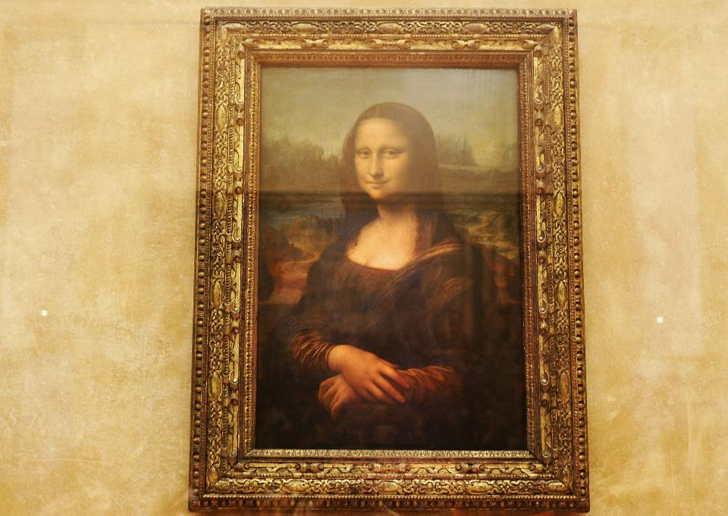

Slide 3
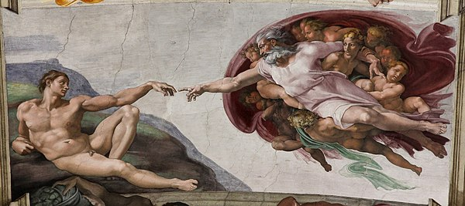

Slide 4
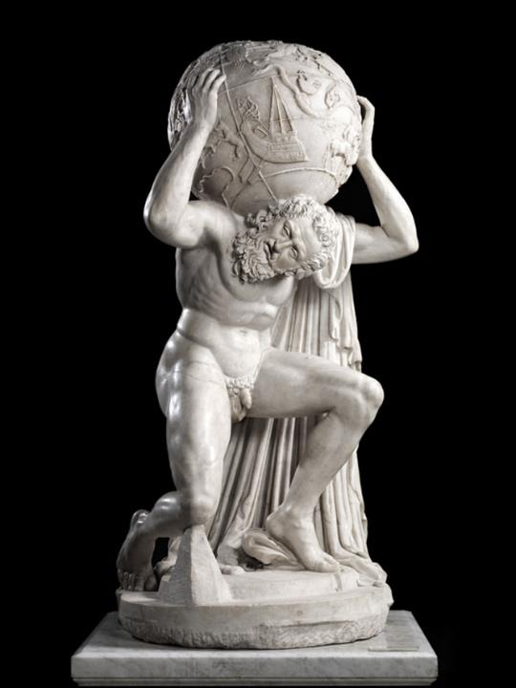

Slide 5
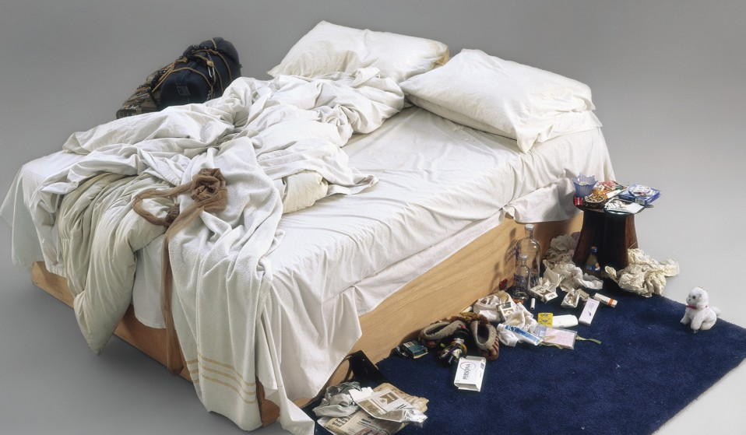

Slide 6
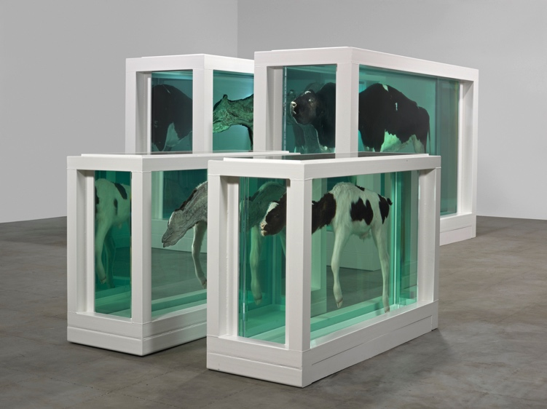

Slide 7
Put an enhance/beautiful selfie here

Slide 8
Put an ugly selfie here

Slide 9
Put a fun selfie here

Slide 10
Put a fun selfie here

Slide 11
Put a fun selfie here

Slide 12
Put a crazy over the top selfie with way too many filters and stickers on it here

Slide 13
#JustOneFilter?

Slide 14

Work of Art
Loved
Enough

Slide 15
“You are God’s work of art, created in Christ Jesus to live the good life as from the beginning he has meant you to live it.”
Ephesians 2:10

Slide 16
#JustOneFilter

