Slide 1

Listening with Love to The Word
In conversation
through
hurting, healing and hope

Slide 2
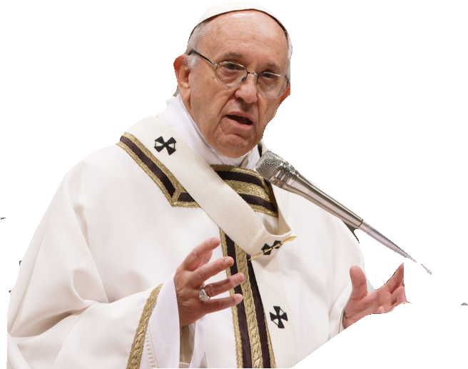
“A church that does not listen... cannot be credible, especially for the young who will inevitably turn away rather than approach.”
Pope Francis 3rd October 2018

Slide 3
Listening with Love to the Word
The Gospel invites us to:
respond to the God of love who saves us
see God in others
go forth from ourselves to seek the good of others
(Pope Francis, Evangelii Gaudium 39)
Speak Lord, your servant is listening
(1 Samuel 3:9)

Slide 4

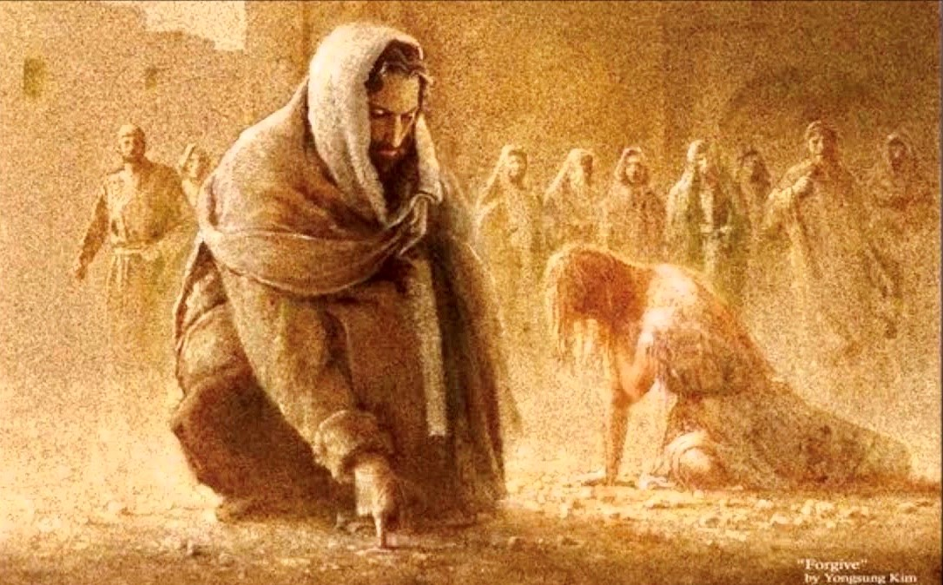
Week Five

Slide 5
Forgiveness
Opening Prayer
O God,
I cannot undo the past, or make it never have happened!
neither can you.
there are some things that are not possible even for you
- but not many!
I ask you, humbly and from the bottom of my heart:
please, God,
would you write straight with my crooked lines?
Out of the serious mistakes of my life will you make something beautiful for you?
Teach me to live at peace with you, to make peace with others and even myself.
Let me experience your love so deeply that I am free to face the future with a steady eye, forgiven, and strong in hope.
Introduction
What does the word ‘Forgiveness’ mean to you?
Short discussion

Slide 6
Forgiveness
Listening with Love to the Word
Holy Spirit, as we listen to the reading,
open our hearts that we may see what you want us to see,
and hear what you want us to hear.
Scripture Reading John 8:3-11
The scribes and Pharisees brought a woman along who had been caught committing adultery; and making her stand there in the middle they said to Jesus,
“Master, this woman was caught in the very act of committing adultery, and in the Law Moses has ordered us to stone women of this kind. What have you got to say?”
They asked him this as a test, looking for an accusation to use against him. But Jesus bent down and started writing on the ground with his finger. As they persisted with their question, he straightened up and said,
“Let the one among you who is guiltless be the first to throw a stone at her.”
Then he bent down and continued writing on the ground. When they heard this they went away one by one, beginning with the eldest, until the last one had gone and Jesus was left alone with the woman, who remained in the middle. Jesus again straightened up and said,
“Woman, where are they? Has no one condemned you?”
“No one, sir,” she replied. “Neither do I condemn you,” said Jesus.
“Go away, and from this moment sin no more.”

Slide 7

The Conversation: Two survivors in conversation
Forgiveness

Slide 8
Reflection
Quiet, personal reflection time to think about what has been said.
Response
What in particular speaks to you about being forgiven?
How would you listen with love?
Closing prayer
Father of hope and consolation be the guardian of all who suffer abuse, send healing for their wounds. Deepen our respect for the dignity of every human life. Heal the brokenness of all victims of abuse, and renew the spirit of all who lament this sin.
Through Christ our Lord
Amen.

Slide 9
If you have been affected by anything that has been shared today, then you may wish to speak to: your Parish Priest, Parish Safeguarding Representative or Diocesan Safeguarding Coordinator.
All contact will be treated in the strictest confidence.

Slide 10
Listening with Love to the Word of God
In conversation through hurting, healing and hope
The Let’s be Honest Group was approached by the Bishops’ Conference to provide some material for Lent 2021. From the beginning, it was recognised that the opportunity to invite people to reflect on the impact of abuse on individuals, and the Church. should not be limited to a particular time and that the resource could be for use at any time.
After an initial discussion about looking at scripture and how it might be reflected upon, as well as how to link the sessions, the members of LBH asked survivors to prepare the resource. The survivors identified the themes and decided that, in conversations the voice of the survivor could be heard. Therefore, using scripture and recorded conversations each session reflects upon the impact of abuse. Participants are invited to listen and reflect.
At the end of the six sessions there is an opportunity to reflect on what has been heard and what it means for the local Church.

Slide 11
Acknowledgements
Scripture quotations are from: the ESV Bible (The Holy Bible, English Standard Version), copyright © 2001 by Crossway, a publishing ministry of Good News Publishers. Used by permission. All rights reserved; The New Jerusalem Bible © 1985 by Darton Longman & Todd Ltd and Doubleday and Company Ltd; Revised Standard Version of the Bible, copyright 1952 [2nd edition, 1971] by the Division of Christian Education of the National Council of the Churches of Christ in the United States of America. Used by permission. All rights reserved.
Prayers — as indicated
Images are taken from the following sources: unsplash.com. My God My God is from Youtube uploaded by Karl Kohlhase October 24th 2014. /cbenson.weebly.com/blog.html. “Stop feeing so lonely and isolated” positivecatalog.com, “God has an amazing way” heartprintofgod.com “Have you ever been so sad” lovethepic.com Walk Emmaus Wallpaper hipwallpaper.com liz lemon swindles Jesus foundationsarts.com Every effort has been to identify and
Listening with Love produced by Let’s Be Honest Group, © 2021 Catholic Trust for England and Wales. Registered Charity in England and Wales no 1097482 Company no. 473592
https://www.cbcew.org.uk/home/events/listening-with-love

